Slide 1
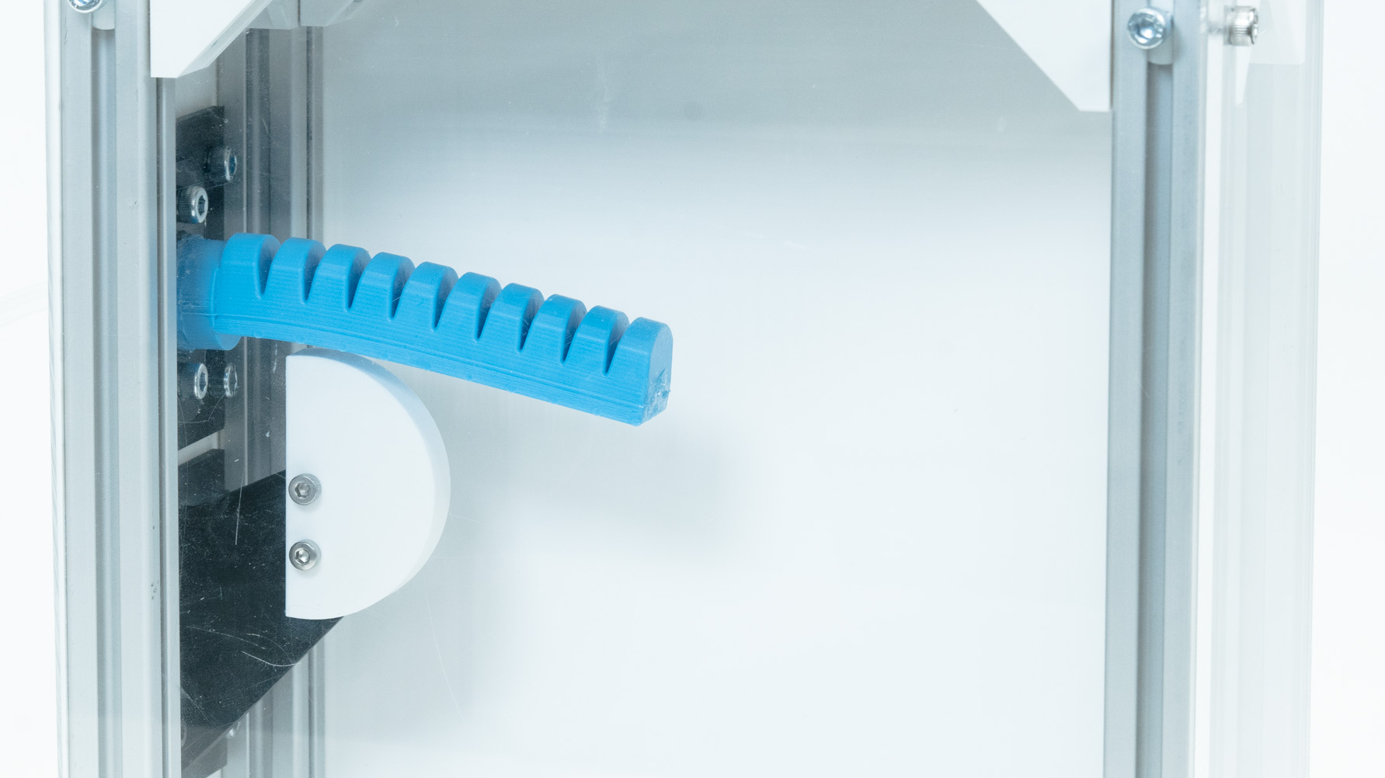
Pneumatic Actuator Test Stand
Evan Comiskey
Fabrication-Integrated Design Lab
Massachusetts Institute of Technology
December 13, 2024
Notes:
Clarify what this presentation is. Overview of the technology and how it works, but not a teaching session.

Slide 2
Agenda
Motivation
Hardware
Control Software
Looking Ahead
Documentation
Notes:
Go over whole plan for presentation to set expectations

Slide 3
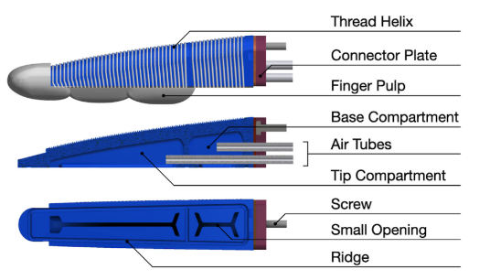
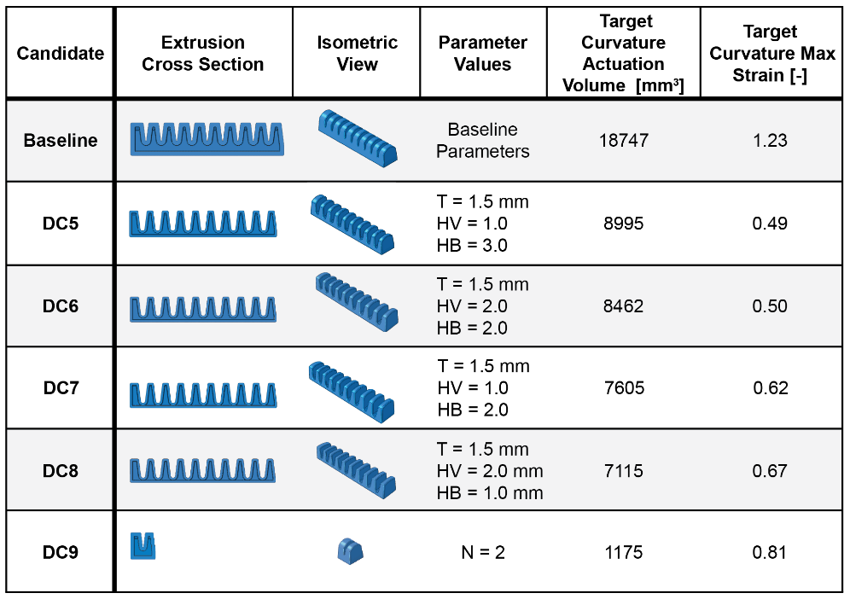
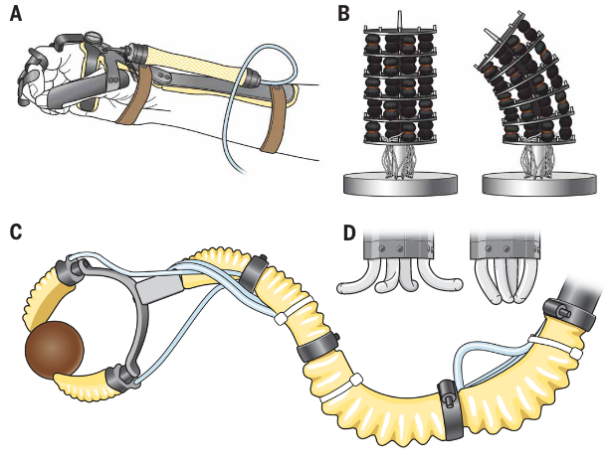
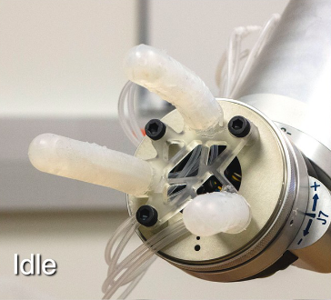
Many new actuator designs
[2]
[1]
[3]
[4]
*References listed on last slide*
Notes:
Talk about the wide array of varying actuator designs out there, and how new ones are constantly developing. Make sure to mention how cycle testing is important to acutators

Slide 4
Lack of unified testing standards
[5]
One key issue seen in the literature is incomplete reporting of test methods and testing equipment. This makes it difficult to fully understand and trust the reported results, to replicate the tests, or to extend or advance the research
[6]
Soft robotics lacks standard benchmarks, metrics, data sets, measurements and characterization workflows, and manufacturing recipes
*References listed on last slide*
Notes:
Could also add discussion about how prior work (Marechal et al.) has used standardized test set-up examine model accuracy, but not sure that it fits super well

Slide 5
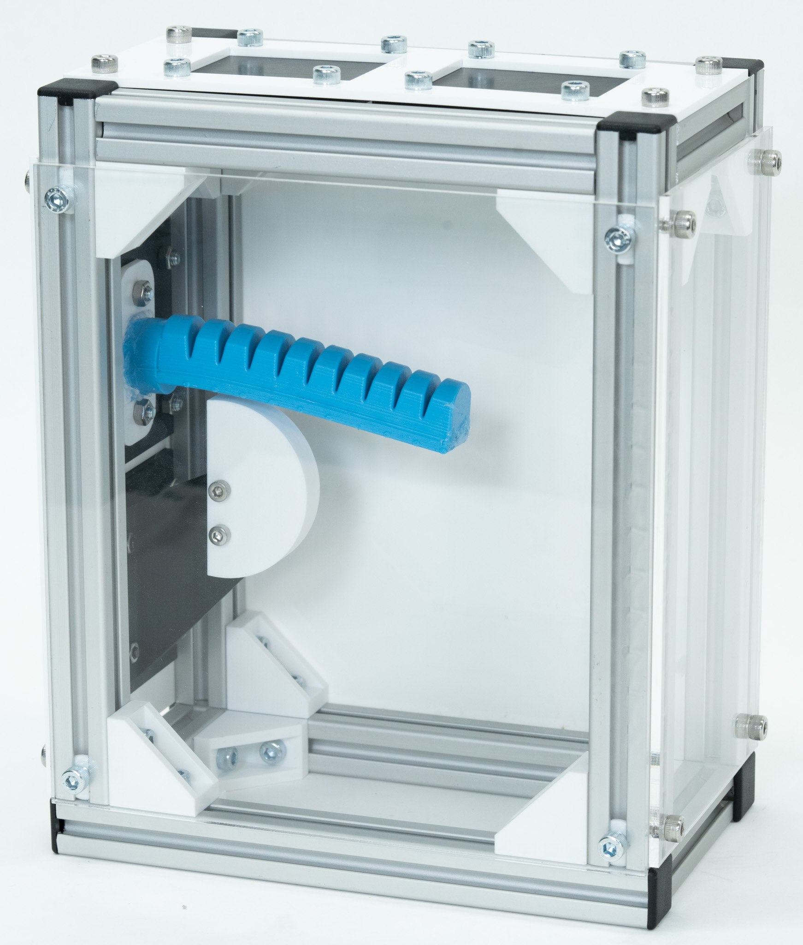
This work: hardware and software for testing pneumatic actuators
Notes:
Discuss the design criterion (only list what believed to be important). Lab drove the need, call to action drove the design. Don’t love the inclusion/phrasing of the last bullet point.

Slide 6
Goal: an open-source, easy-to-use test stand
with repeatable data collection
for demonstrating actuator designs decisions
Notes:
Discuss the design criterion (only list what believed to be important). Lab drove the need, call to action drove the design. Don’t love the inclusion/phrasing of the last bullet point.

Slide 7
Goal: an open-source, easy-to-use test stand
with repeatable data collection
for demonstrating actuator designs decisions
Make all aspects publicly available so others may use, modify, and expand upon
Notes:
Discuss the design criterion (only list what believed to be important). Lab drove the need, call to action drove the design. Don’t love the inclusion/phrasing of the last bullet point.

Slide 8
Goal: an open-source, easy-to-use test stand
with repeatable data collection
for demonstrating actuator designs decisions
Allows reconfiguration without redesign for new actuators, valves, etc.
In-depth documentation and code commenting makes pneumatic controller customization accessible to non-programmers
Notes:
Discuss the design criterion (only list what believed to be important). Lab drove the need, call to action drove the design. Don’t love the inclusion/phrasing of the last bullet point.

Slide 9
Goal: an open-source, easy-to-use test stand
with repeatable data collection
for demonstrating actuator designs decisions
Previous two points grant ability for different labs to recreate the same data
Notes:
Discuss the design criterion (only list what believed to be important). Lab drove the need, call to action drove the design. Don’t love the inclusion/phrasing of the last bullet point.

Slide 10
Goal: an open-source, easy-to-use test stand
with repeatable data collection
for demonstrating actuator designs decisions
Setup allows for comparing and validating various actuator design decisions
Notes:
Discuss the design criterion (only list what believed to be important). Lab drove the need, call to action drove the design. Don’t love the inclusion/phrasing of the last bullet point.

Slide 11
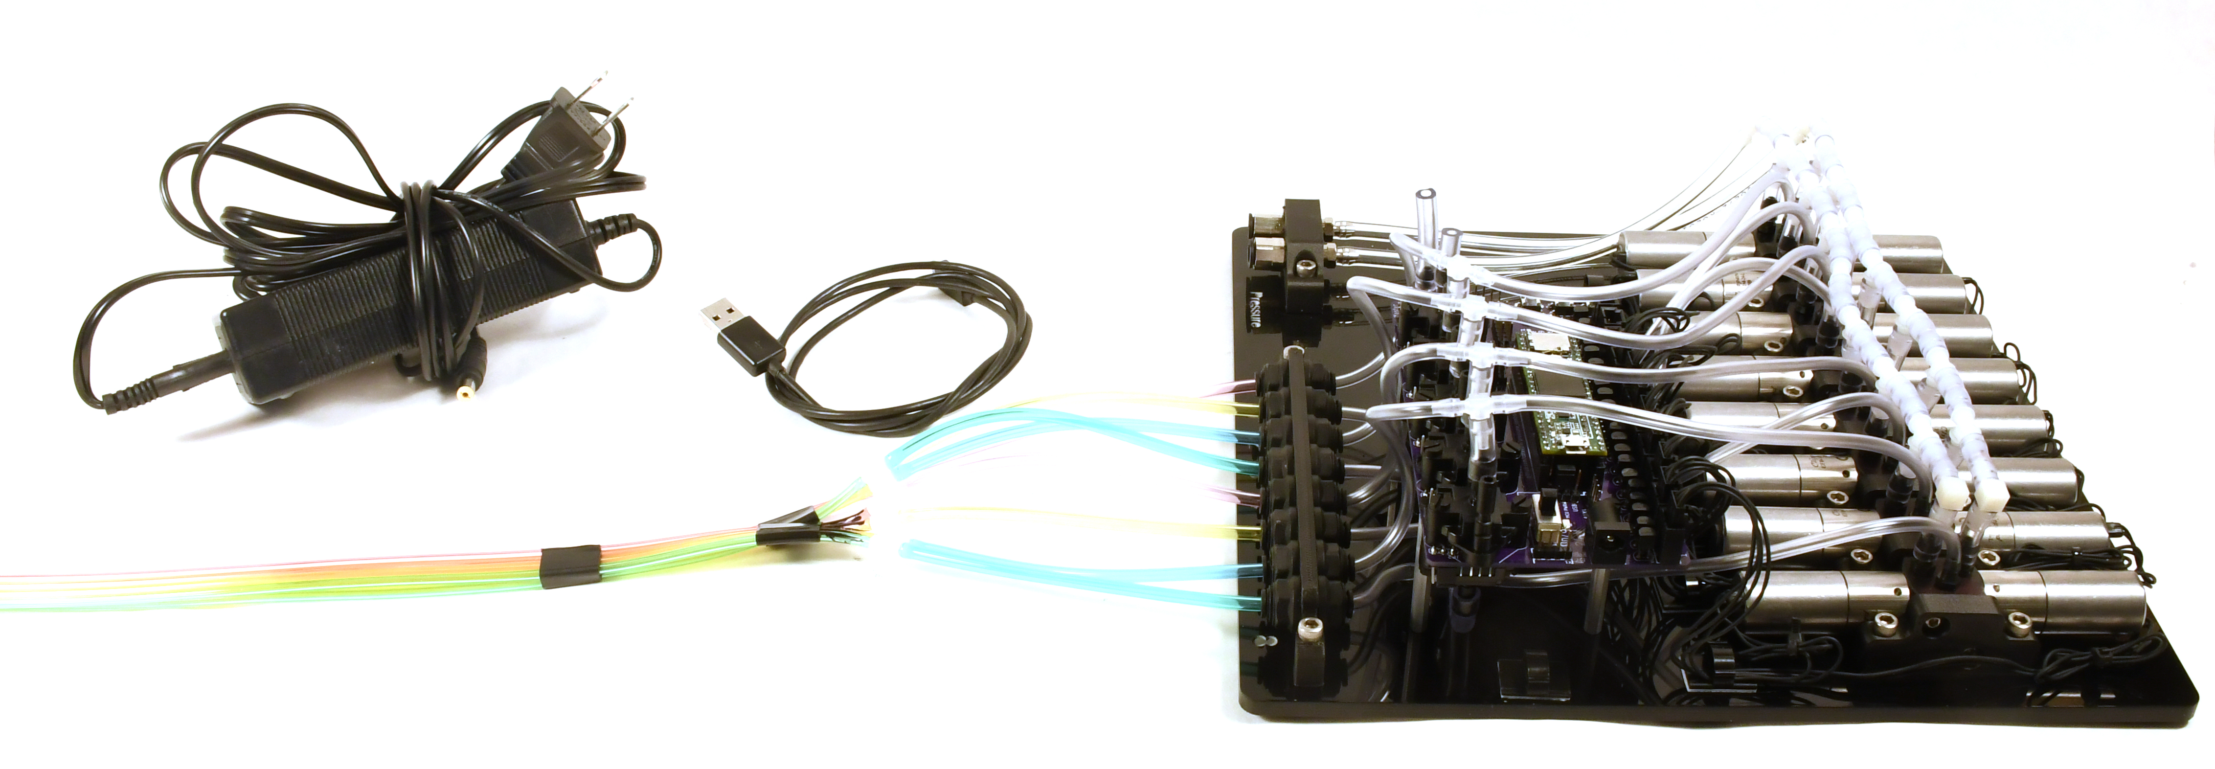
Prior work
Multiple Outputs to volume
Multiple Solenoid Control Valves
Air inlet
Citation: Clarke Teeple, https://ctrl-p.cbteeple.com/latest/index.html
Notes:
Make brief comment about my work taking inspiration from Clark’s. His was focused on manipulation of many DOF’s at once, which capped the number of cycles the machine could run at. I am focused on long, repeated testing of one DOF (or actuator).

Slide 12
Agenda
Motivation
Hardware
Control Software
Looking Ahead
Documentation
Notes:
Hardware section will highlight the open-source nature of hardware, the customization of the 3d-printable plates, how the plates and electronics make high repeatability easy. Easy of isolation/maintaining physical variables of interest, and ease of use w/ camera/media (that also provides safety too)

Slide 13
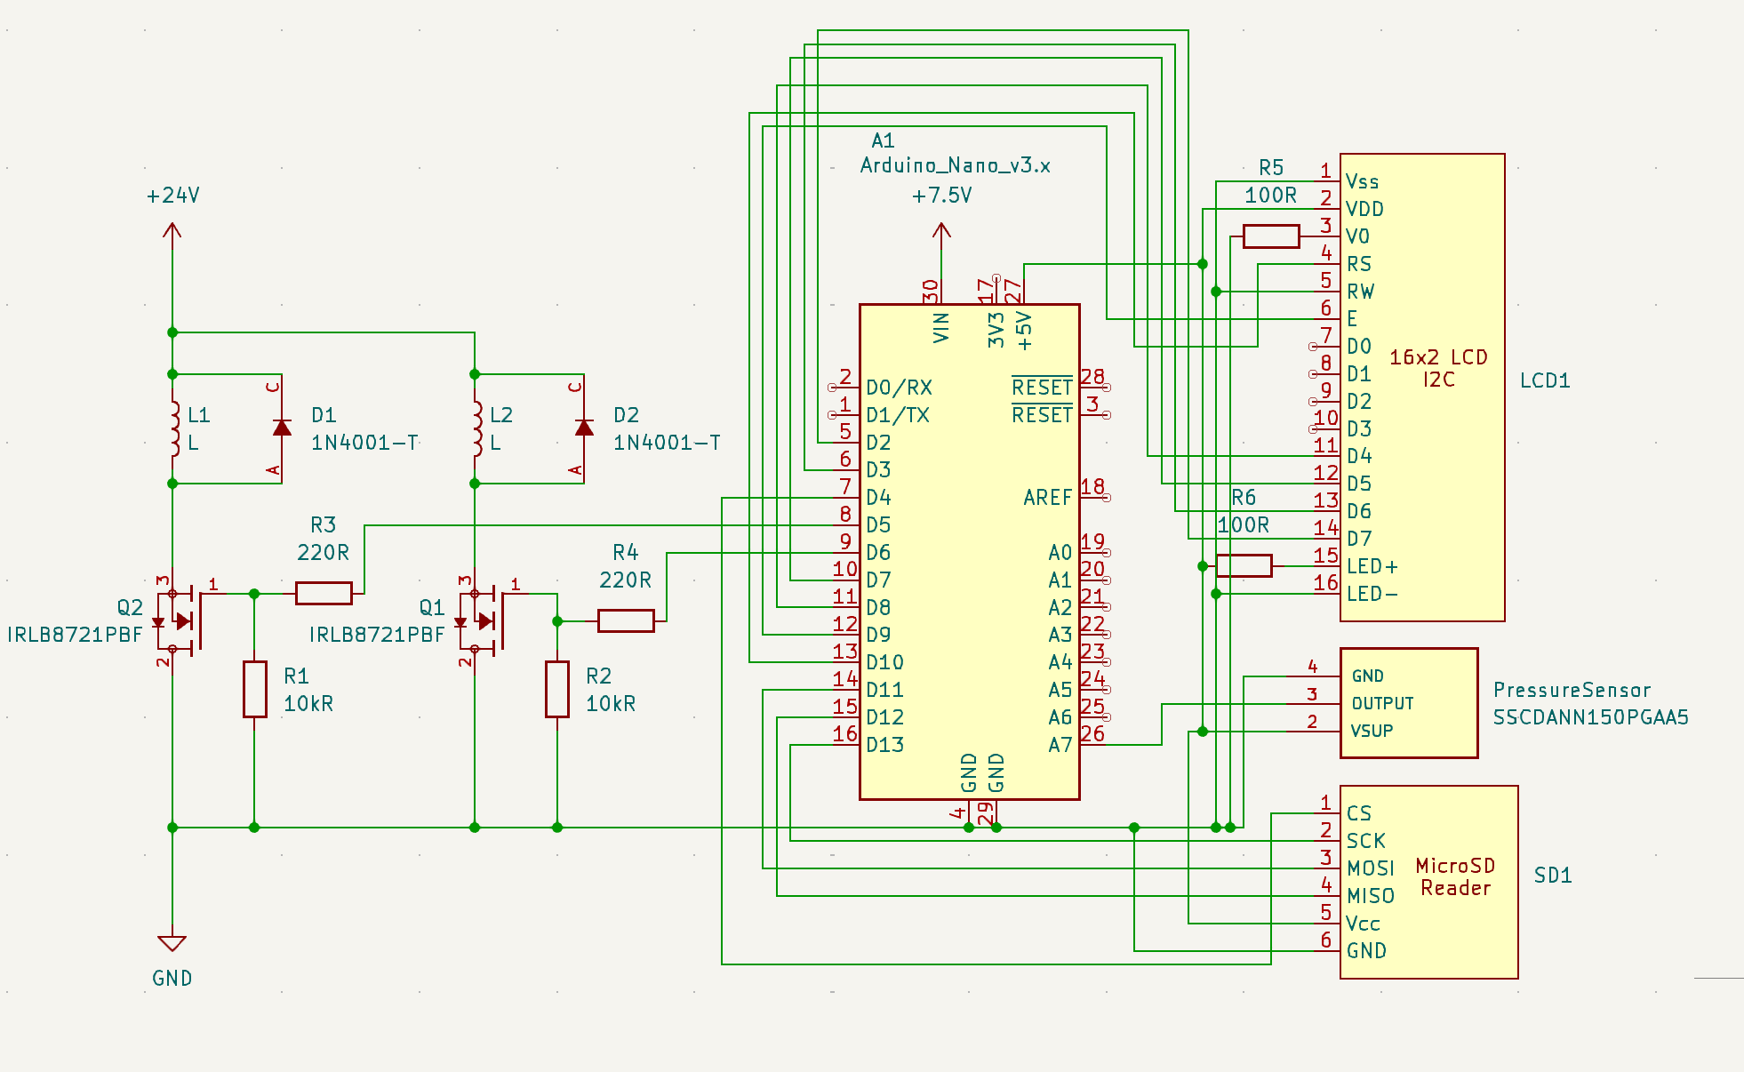
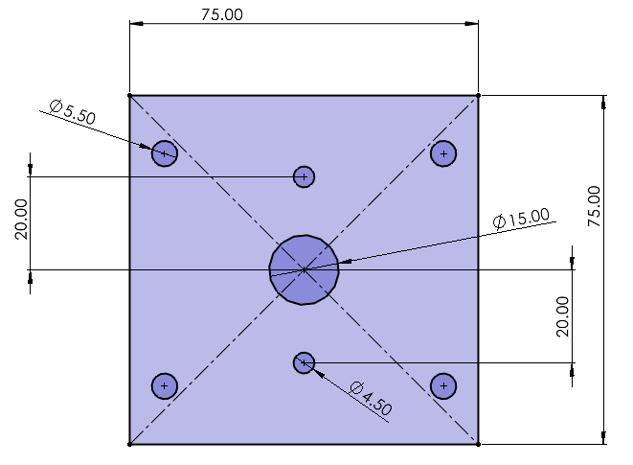
Open-source hardware
Schematics of all hardware and electronics used to be publicly available for others to recreate and adapt for their own experiments
Notes:
Be sure to mention that there will be a public BOM. All dimensions and schematics to be publicly accessible.

Slide 14
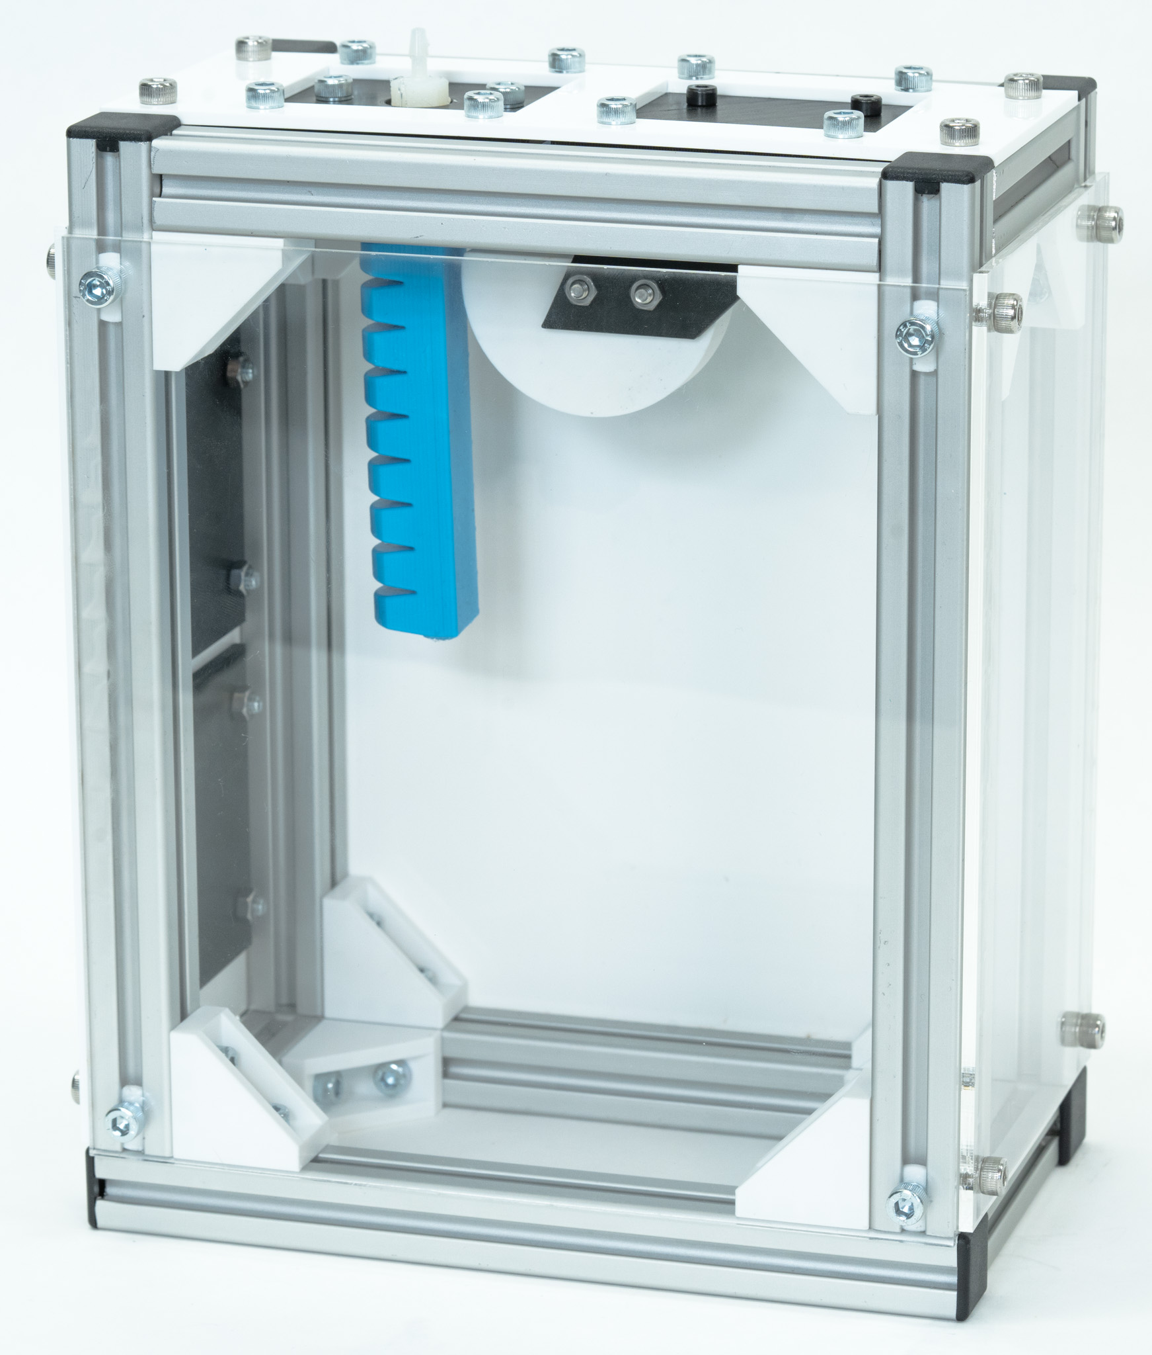
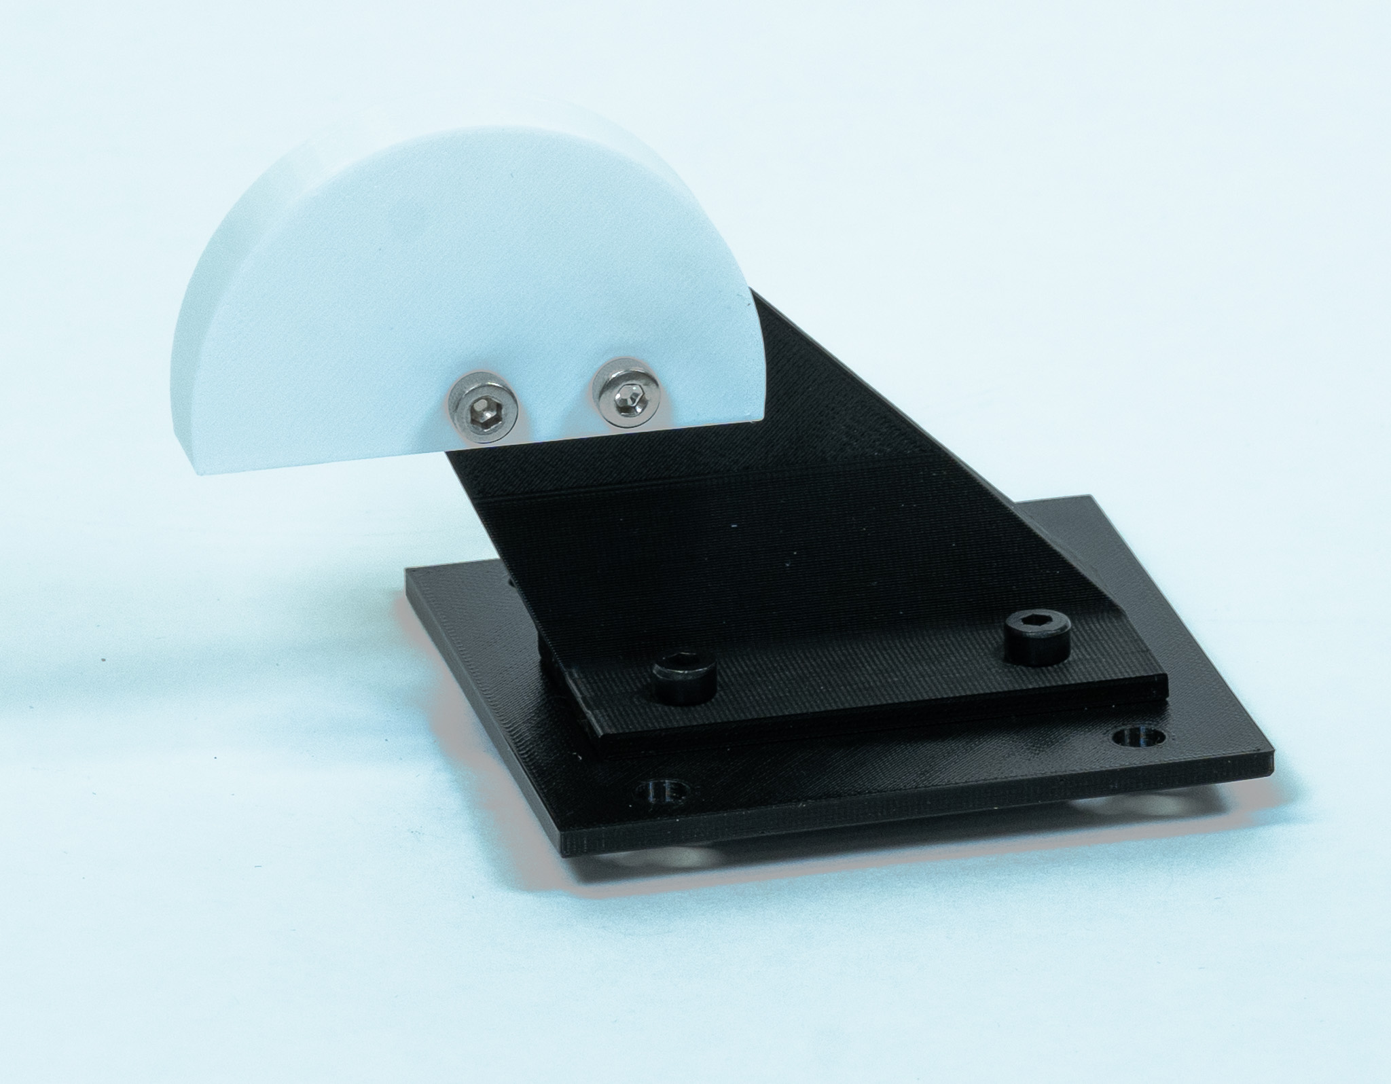
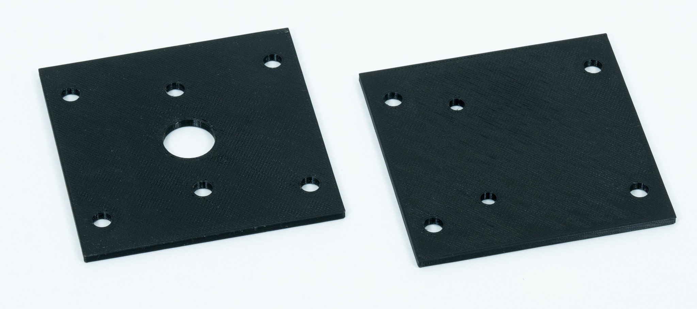
Modularity
All mounting equipment for sample objects and actuators can be fabricated using 3d printing
Allows stand to accommodate any actuator design or desired test set-up in either horizontal or vertical orientation
Notes:
Mention speed of changing test-set-up due to fabrication times. Ease of installation with just a few screw changes. High set-up visibility makes it easy to include as paper figures

Slide 15
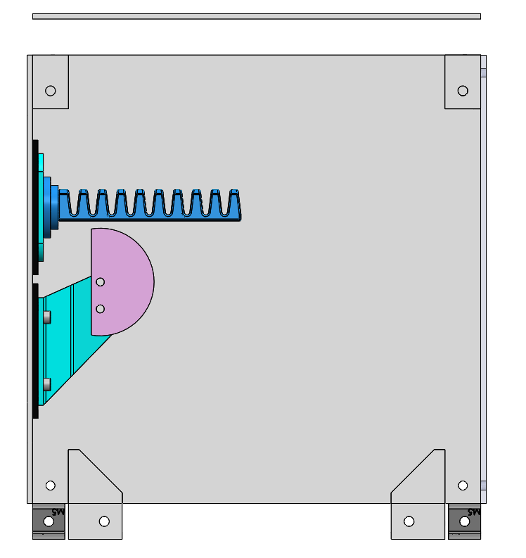
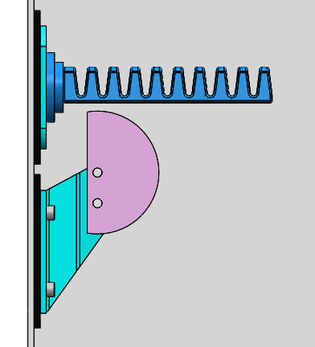
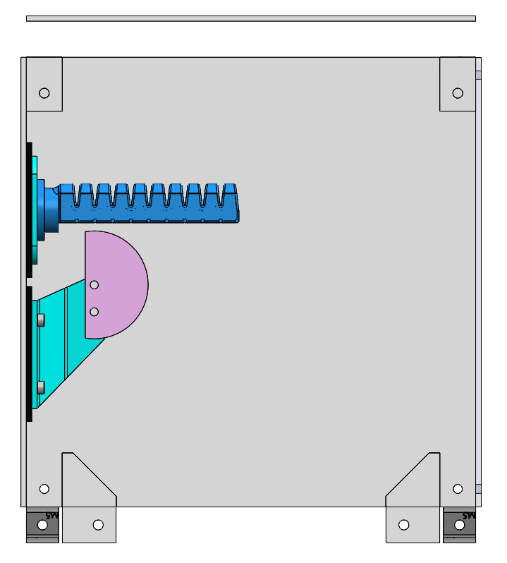
Easy to work with variables of interest
Flexibility in modularity makes isolating any physical variable between different test conditions simple
x₁
x₁
x₁
Notes:
Still leaning on modularity and repeatability, talk about process of isolating x₁ variable with CAD and additive manufacturing. Mention repeatability of same experiment with different versions of the same acutator

Slide 16
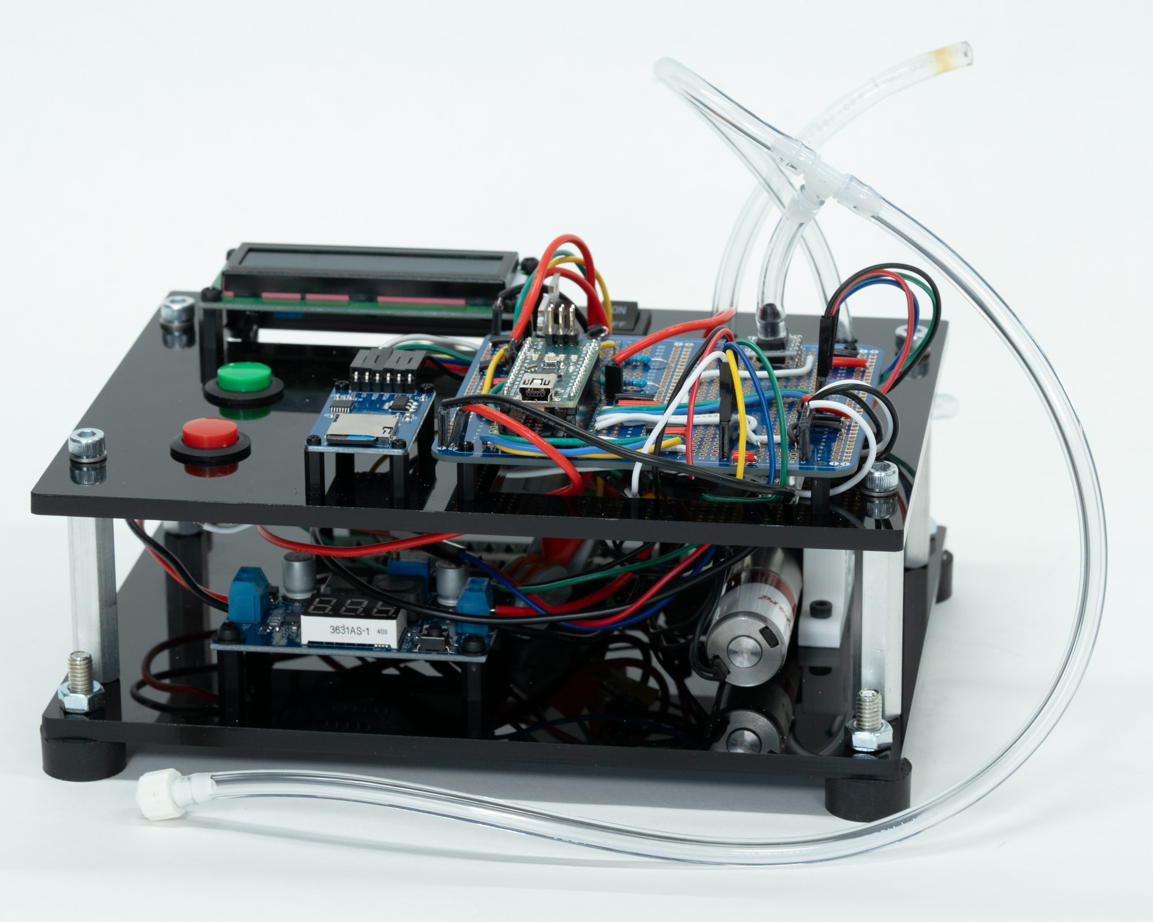
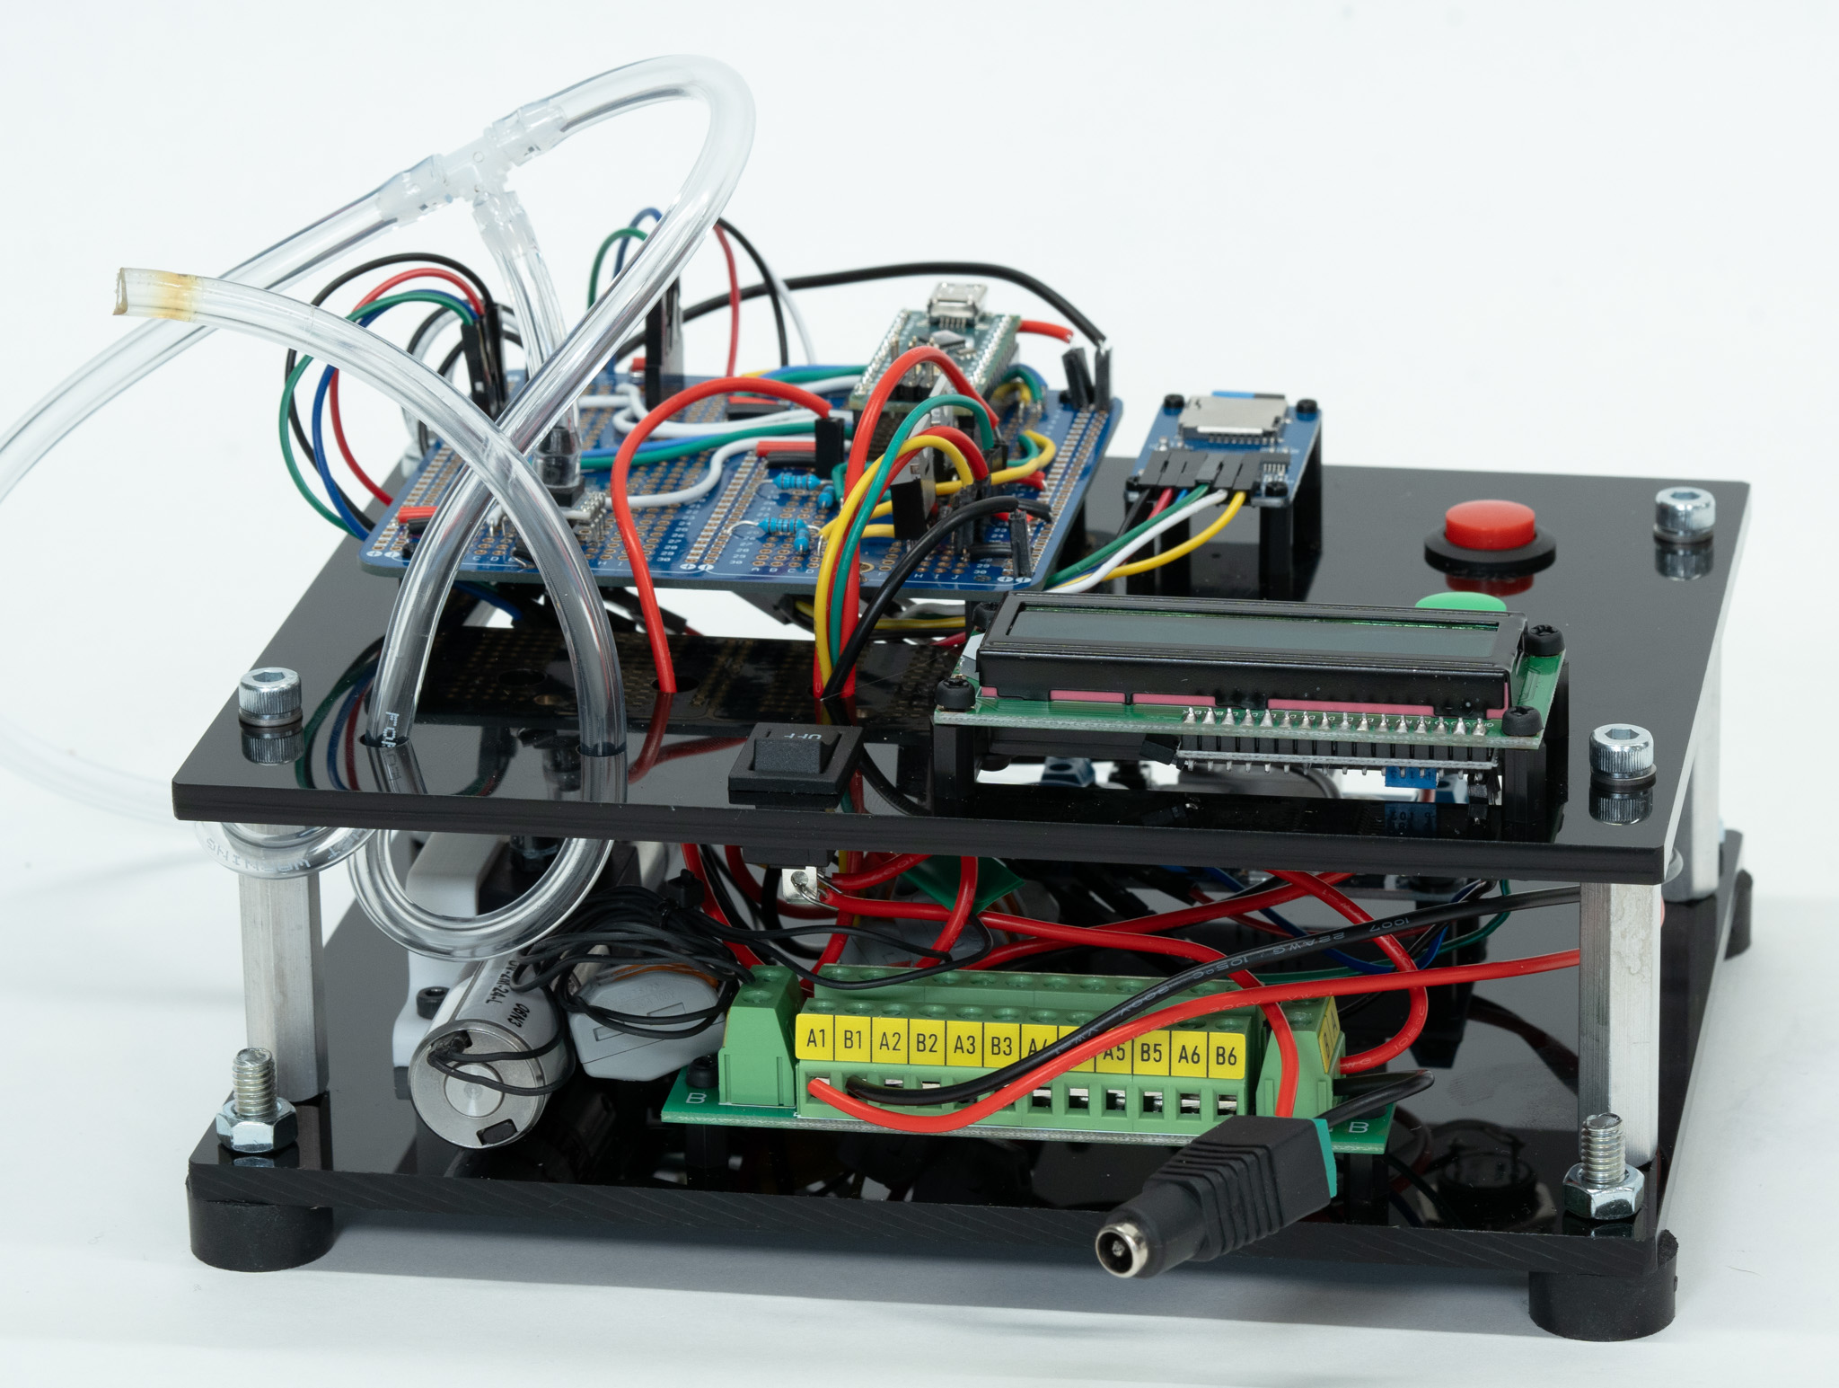
Electronics & Pneumatics
Inlet pressure line
Front:
Back:
MicroSD carrier board
Solenoid
Output to volume
Barrel-jack power
Notes:
Comment on quick information communication in paper figures, and on safety during tests due to shielding.

Slide 17
Agenda
Motivation
Hardware
Control Software
Looking Ahead
Documentation
Notes:
Explain that I will review PID control since some people who may want to use this controller are not very familiar with it, then demonstrate this specific controller’s capabilities, then its limts

Slide 18
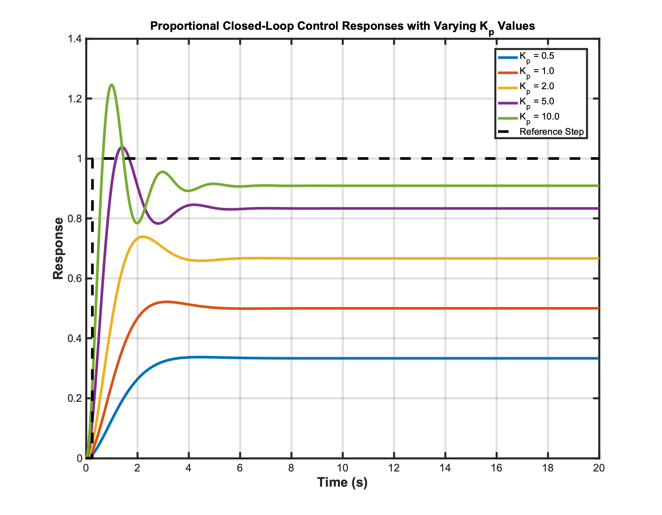
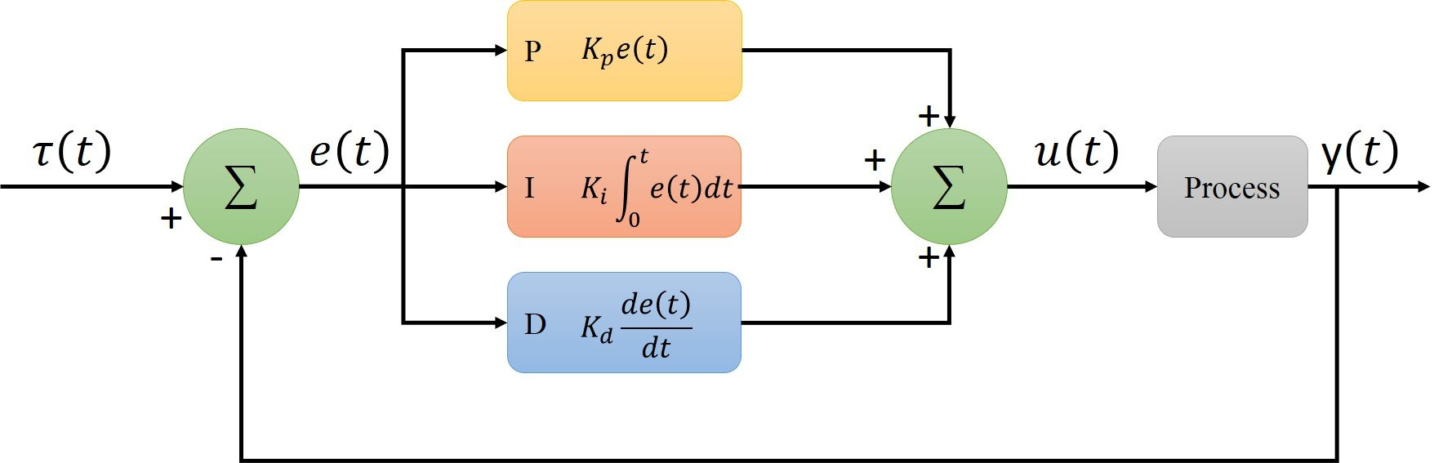
PID control overview
Where $e\left(t\right)=reference signal −measured signal$
An engineer chooses the gain ($K$) values
Design criteria inform $τ(t)$
Notes:
Do I need to cite Wikipedia for images, in the context of a lab presentation and also conference presentations?

Slide 19
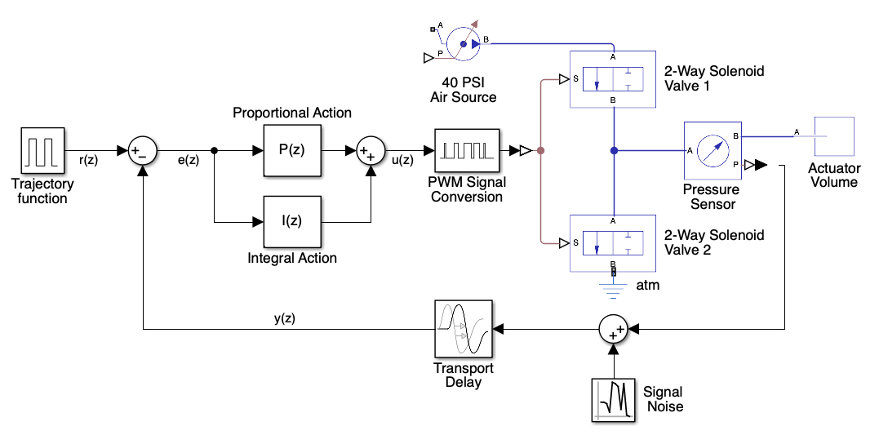
This stand’s pneumatic PID control system
Where z = 1 time step of the control system

Slide 20
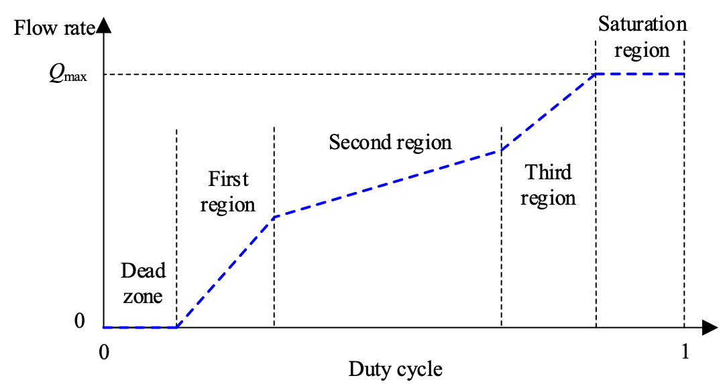
PWM Signal Conversion
Controller output is converted to PWM signal for linear control of solenoid valve’s open/closed state
Tuning procedure in documentation seeks to ensure that analog signals sent to the solenoids are lie near the start and end of the linear regime for that specific valve
[7]

Slide 21
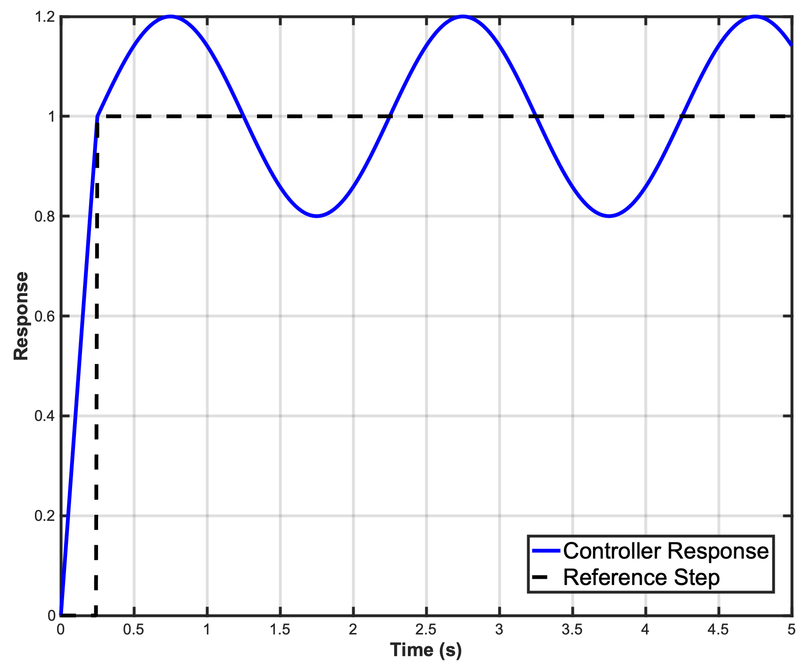
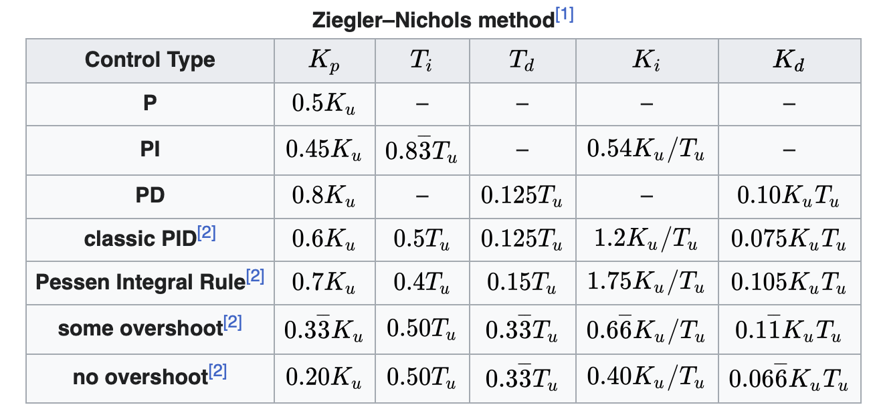
Ease of set-up
T_{i}
Zeigler-Nichols Tuning Process
Increment K_{P} until oscillations occur at a steady state
Set this K_{p} as K_{u}
Measure the steady state oscillation period, T_{i}
*Expanded, pictographic instructions to be included in the documentation

Slide 22
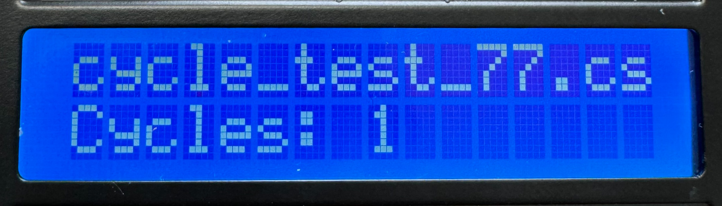
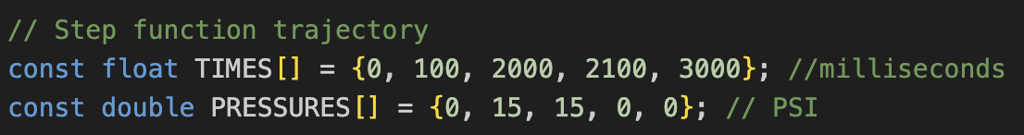
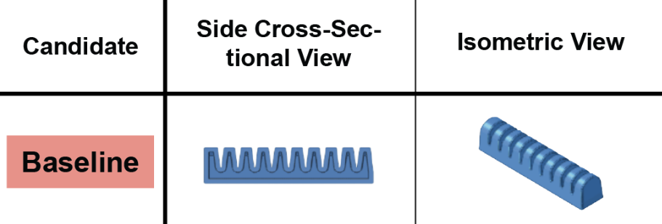
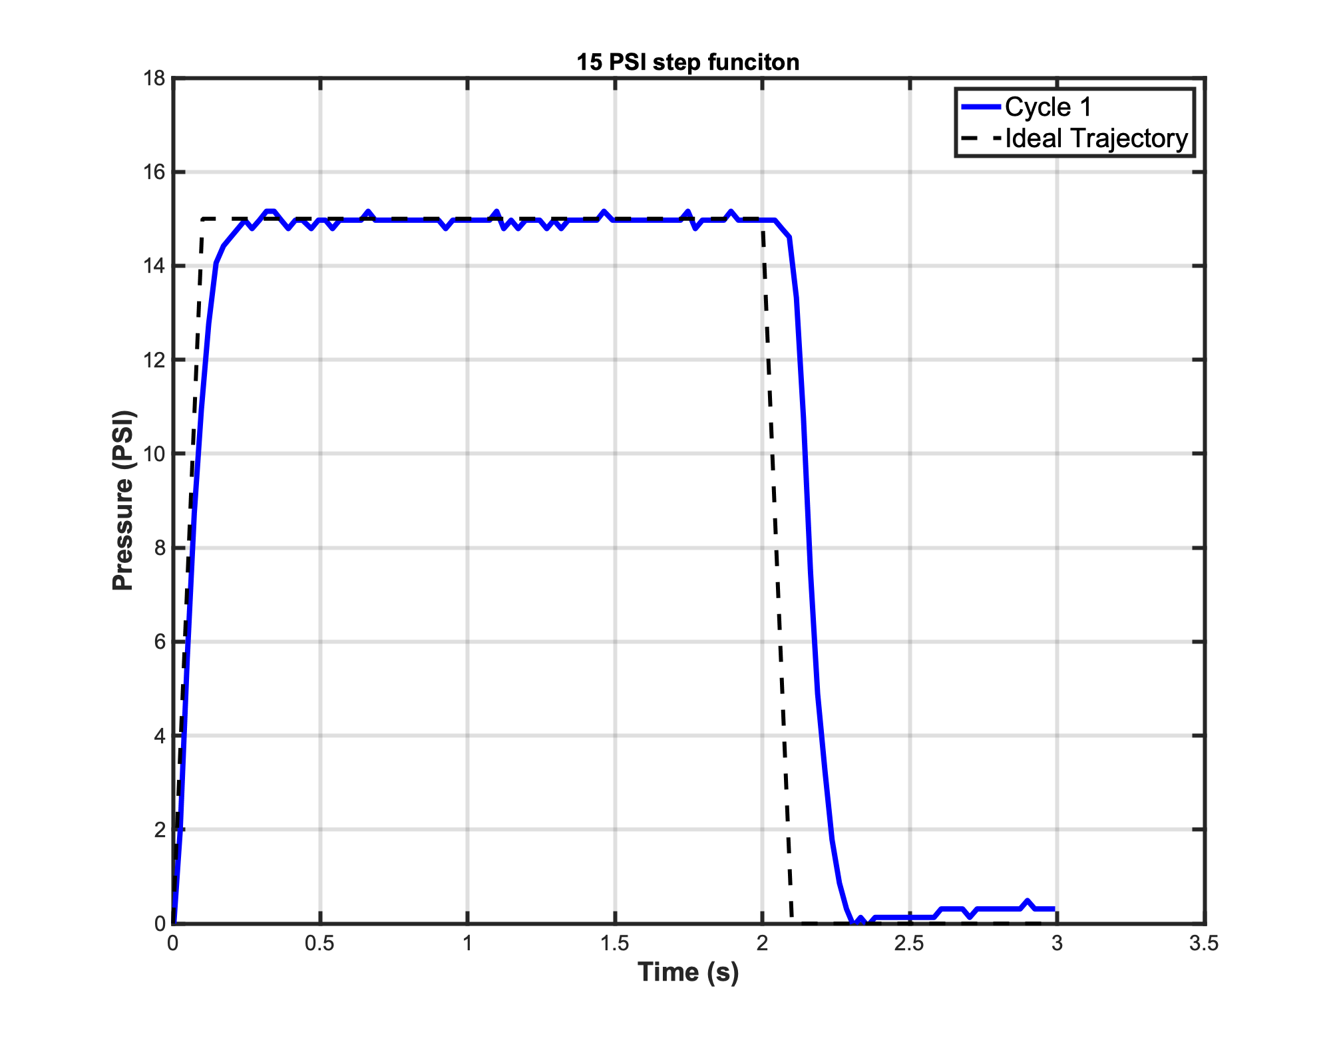
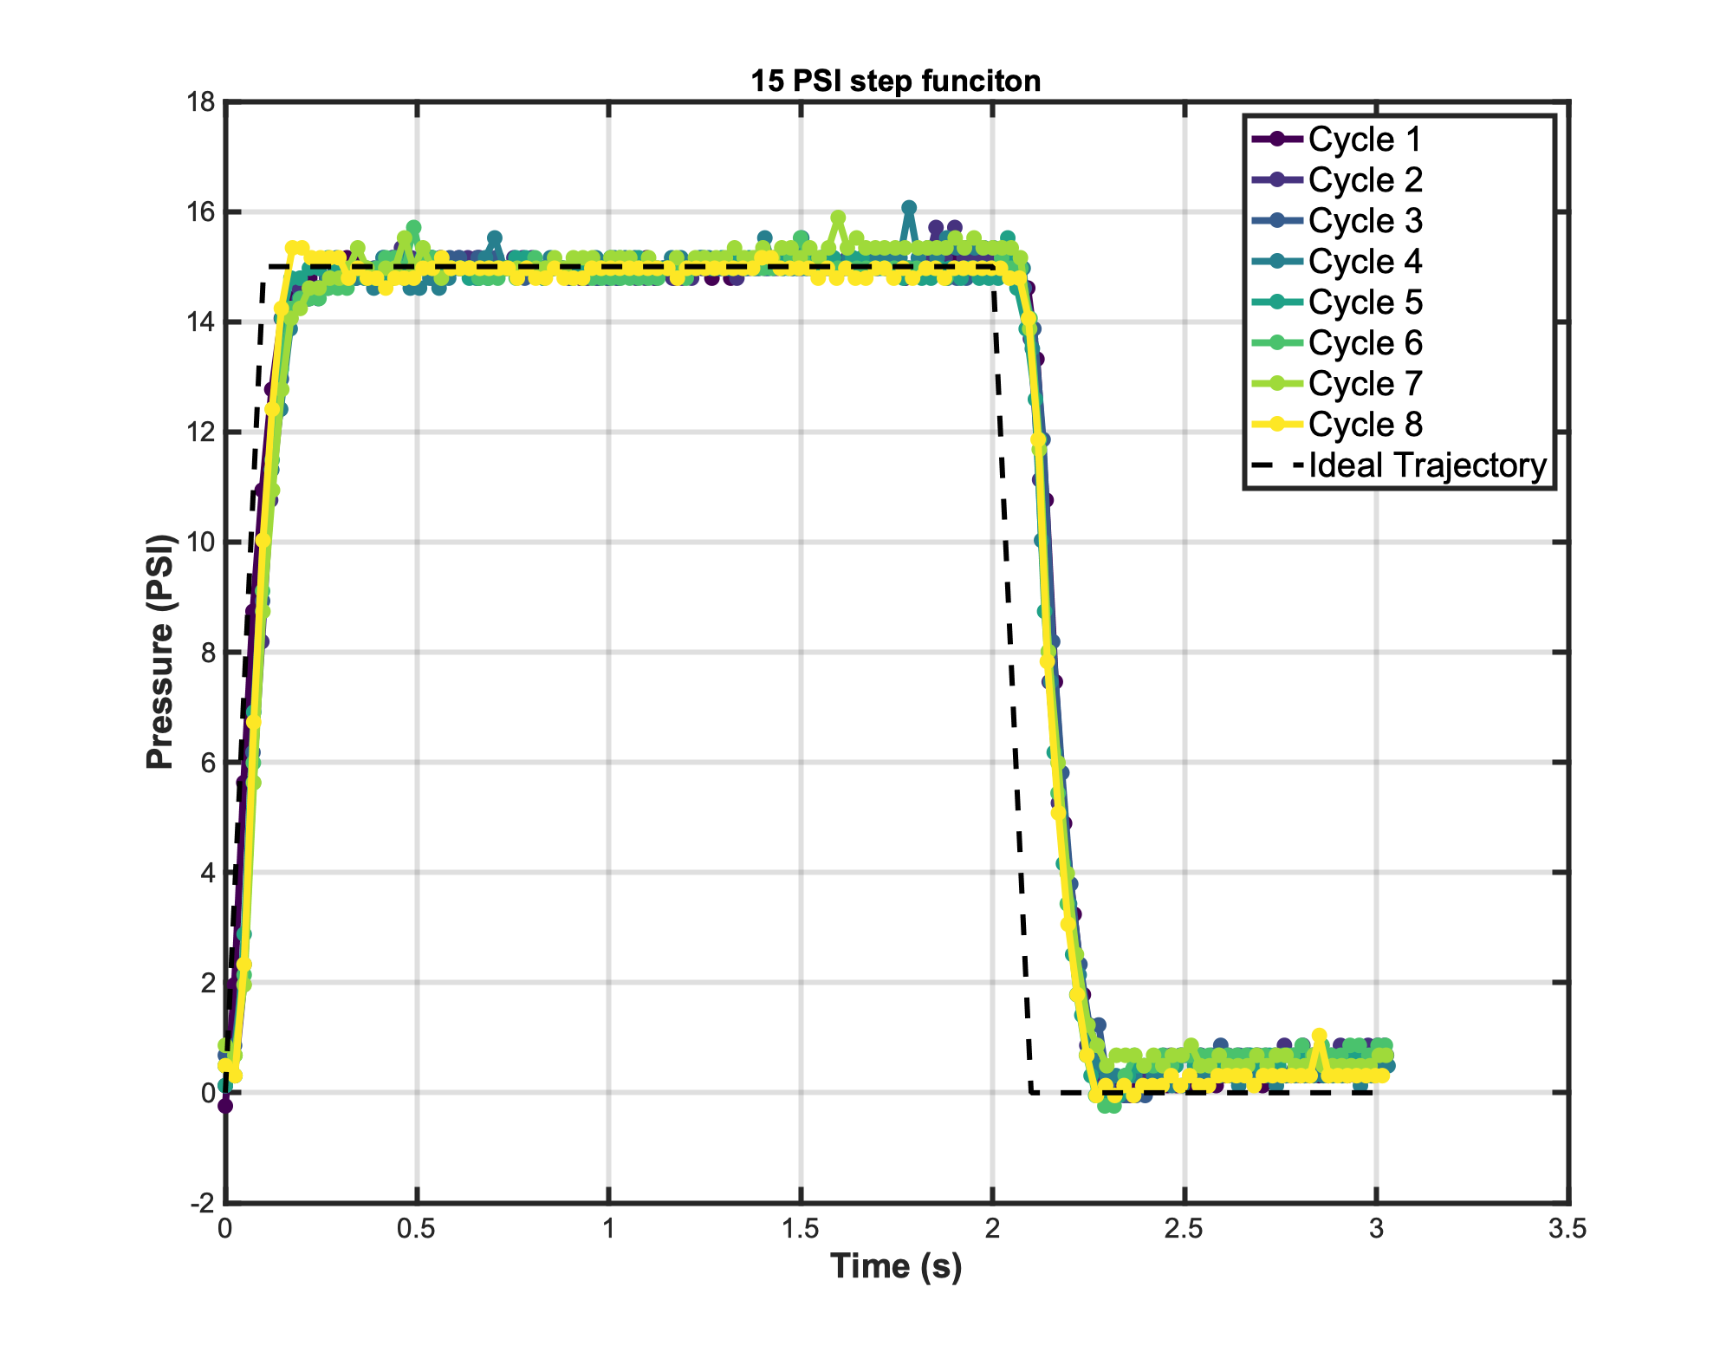
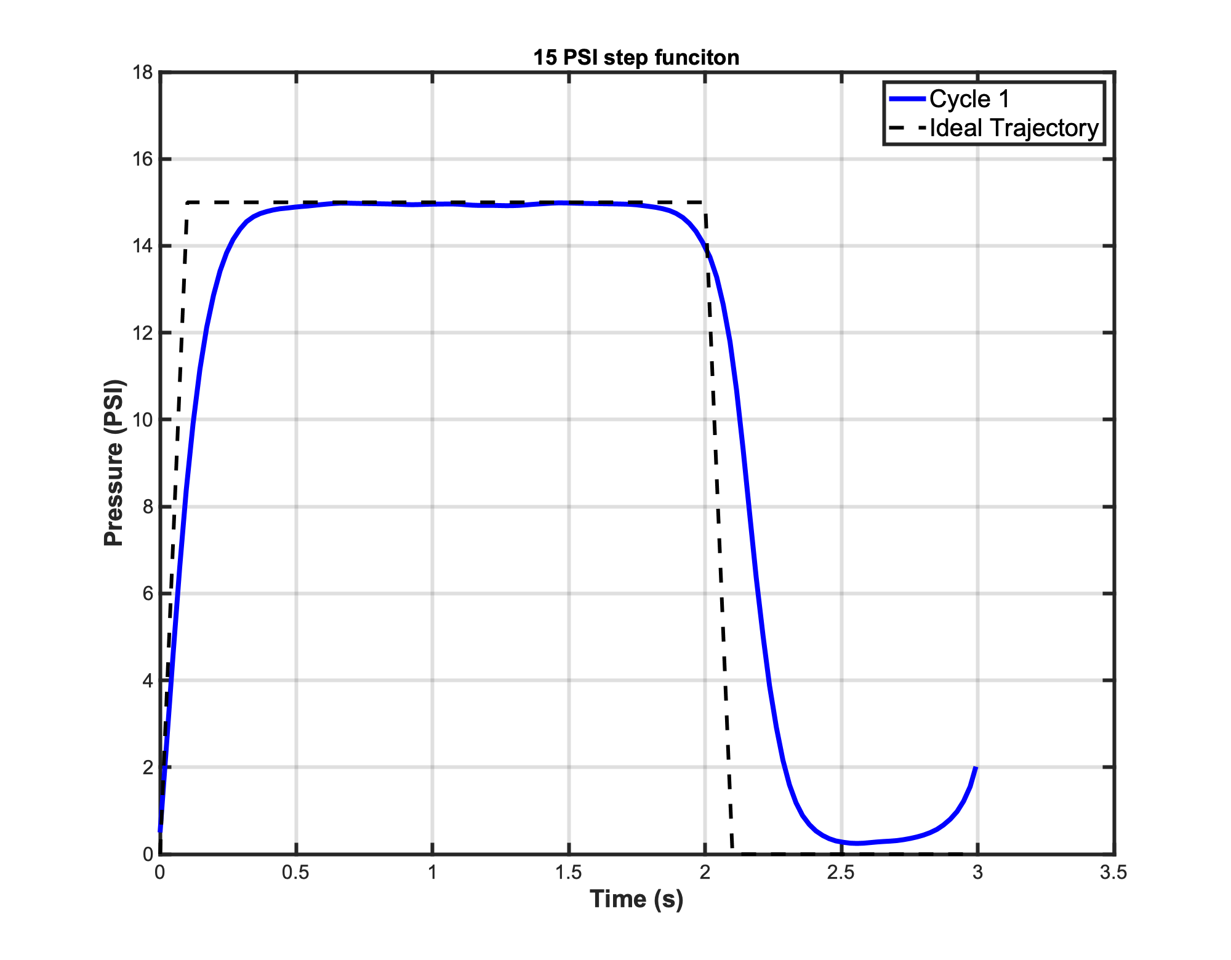
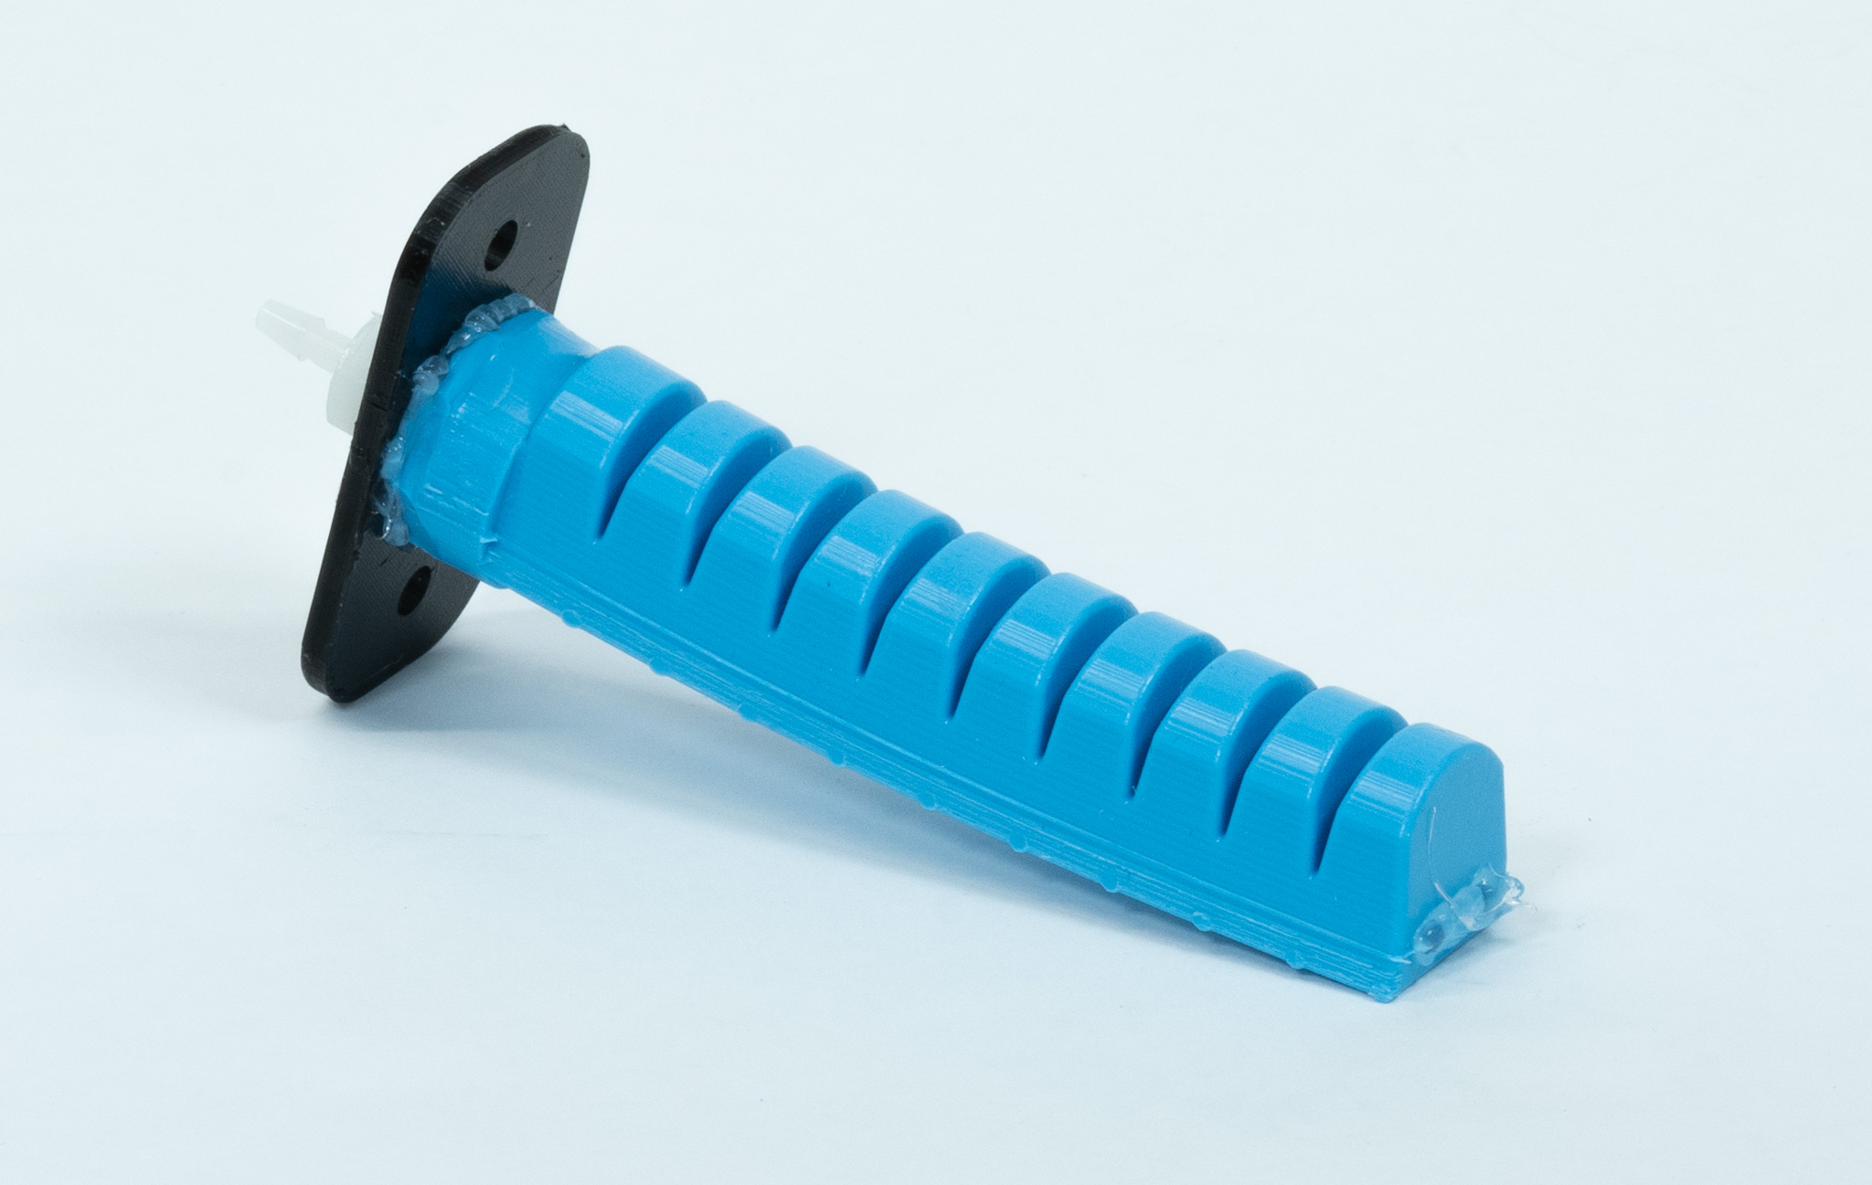
What data looks like
[1]

Slide 23
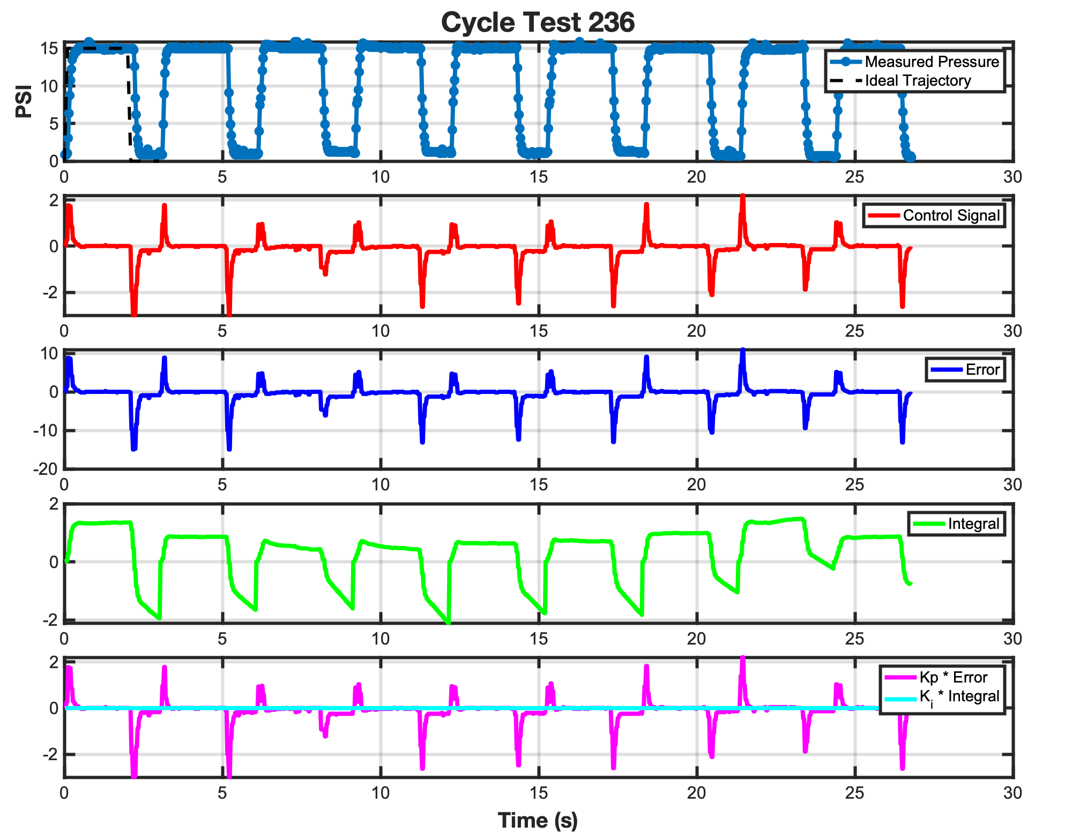
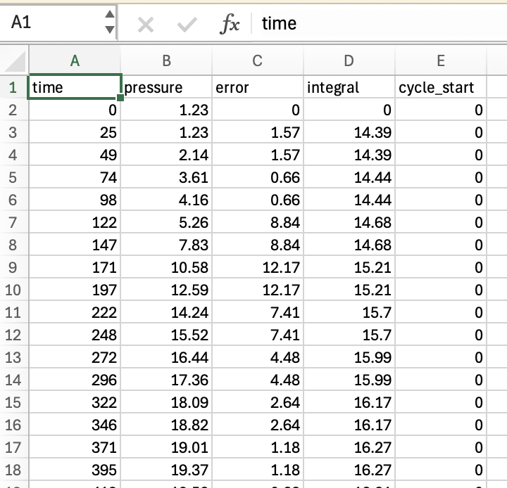
What data the microSD collects
Running the tester automatically generates the shown data, which can be used to communicate actuator behavior, or for controller debugging

Slide 24
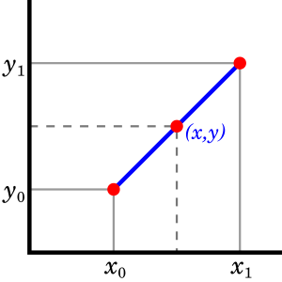
The trajectory is interpolated in real time
To keep defining controller trajectories simple for users, linear interpolation is performed between explicitly defined setpoint timesteps at a user-defined frequency.
A user’s choice in setpoint granularity and interpolation rate is informed by the complexity of the trajectory a user wishes an actuator to follow, and how well the associate controller gains can be tuned.

Slide 25
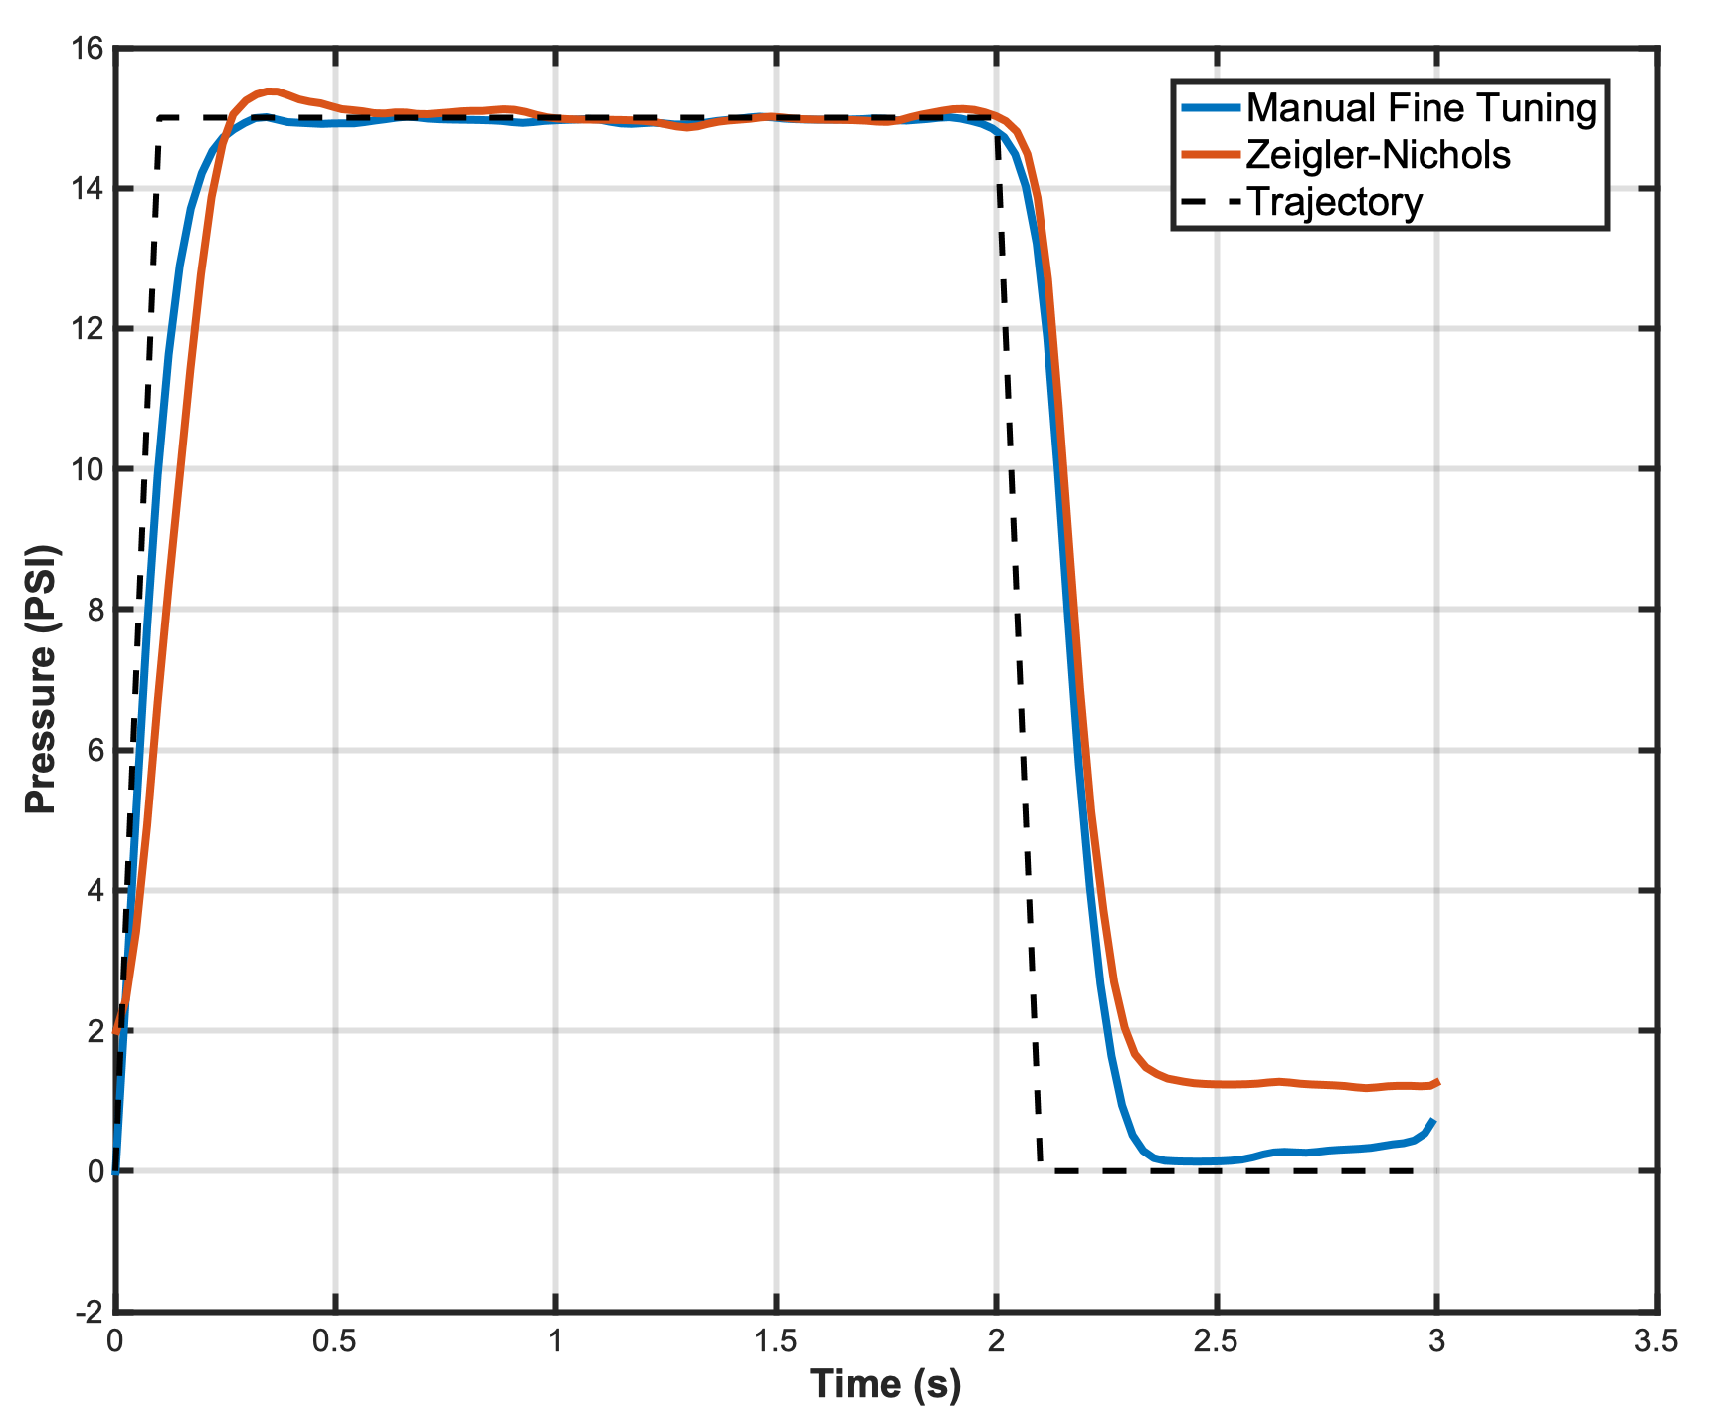
Zeigler-Nichols & ideal gains
This controller has the capacity to follow programmed trajectories with high accuracy
Zeigler-Nichols tuning:
K_{p} = 0.675
K_{i} = 0.00324
Fine manual tuning:
K_{p} = 0.4
K_{i} = 0.00115
Notes:
Talk about how they are very similar, but the ideal tuning shows a better response on the decent

Slide 26
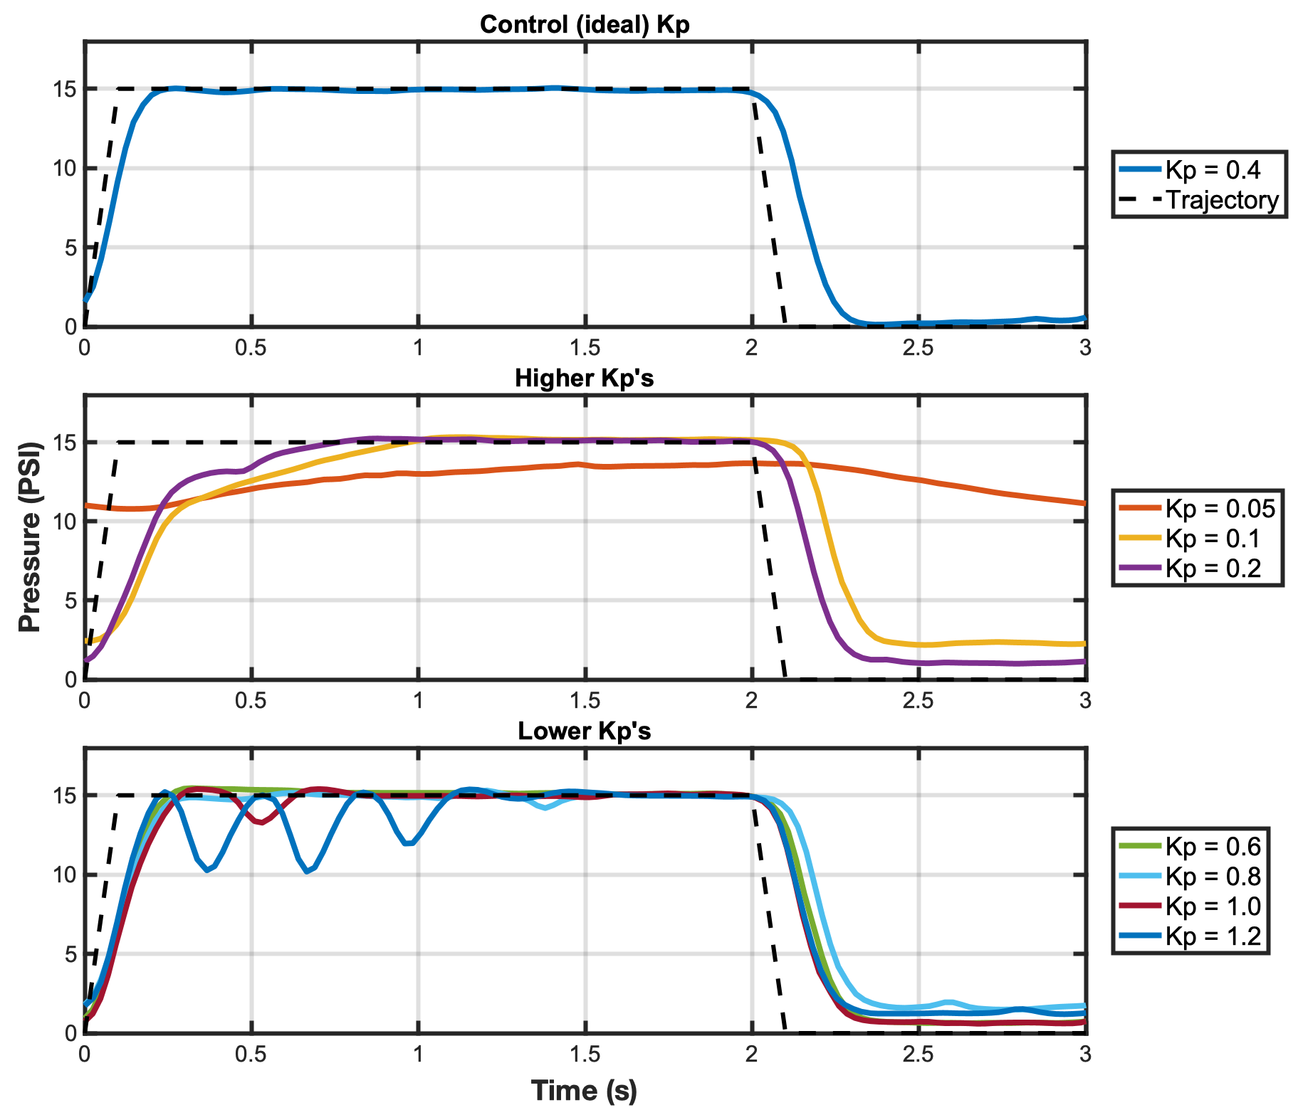
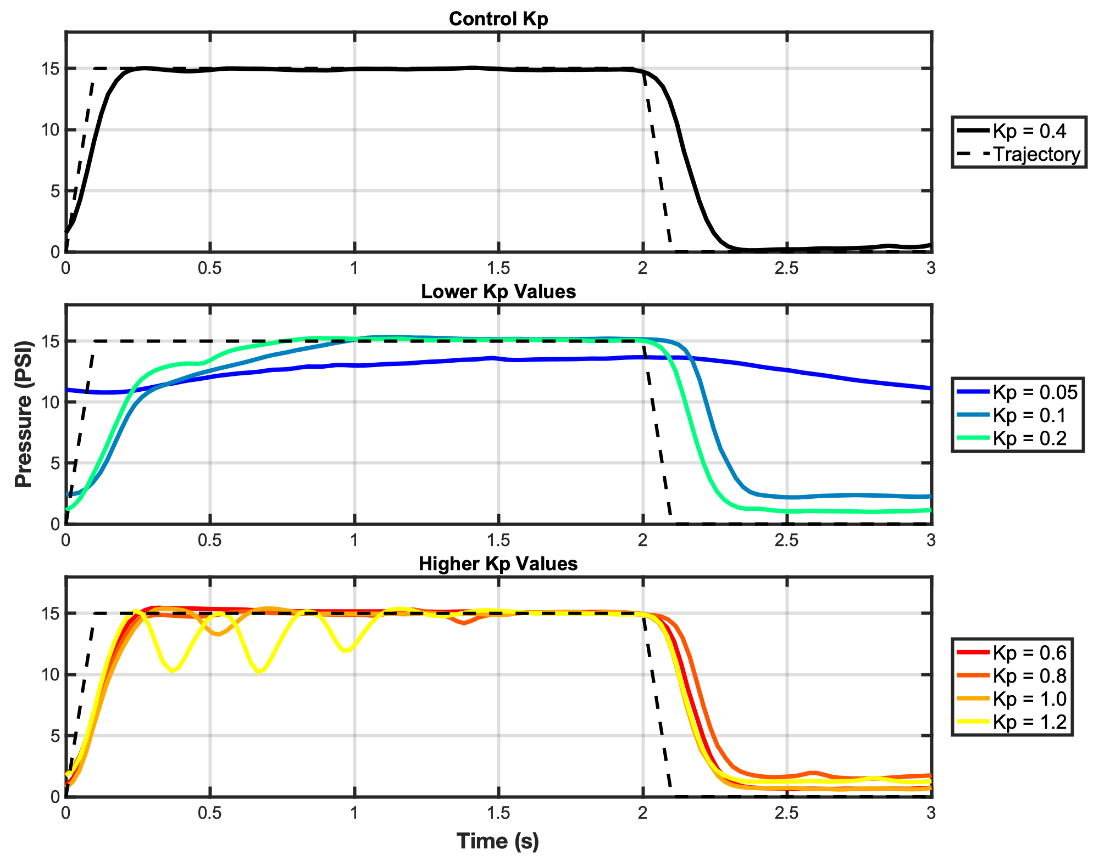
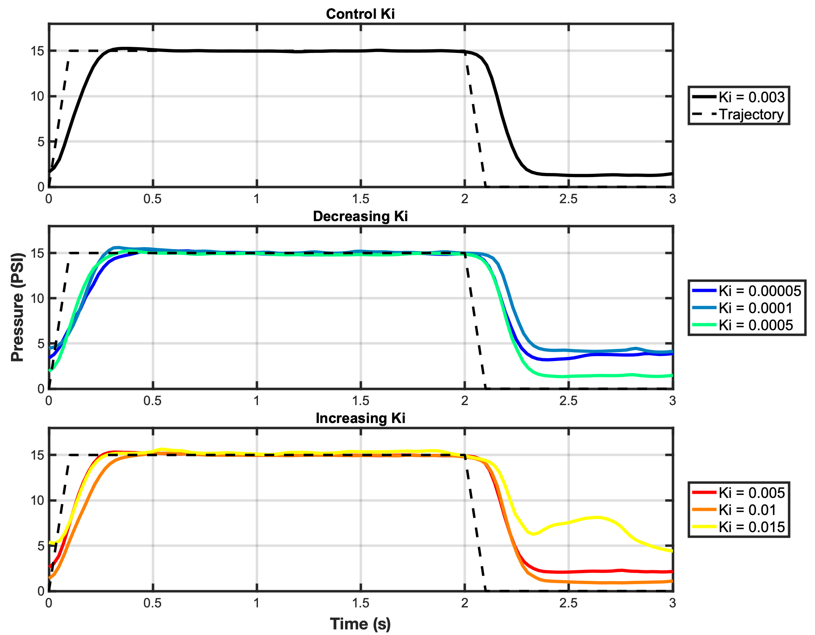
Adjusting gains
With high flow rates, system gains are small in magnitude:
K_{p} on the order of 10⁻¹
K_{i} on the order of 10⁻³
K_{d} unnecessary given system response speed

Slide 27
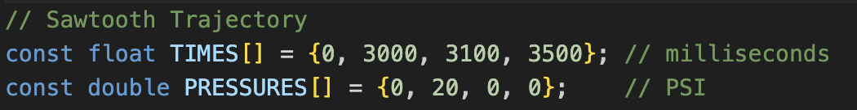
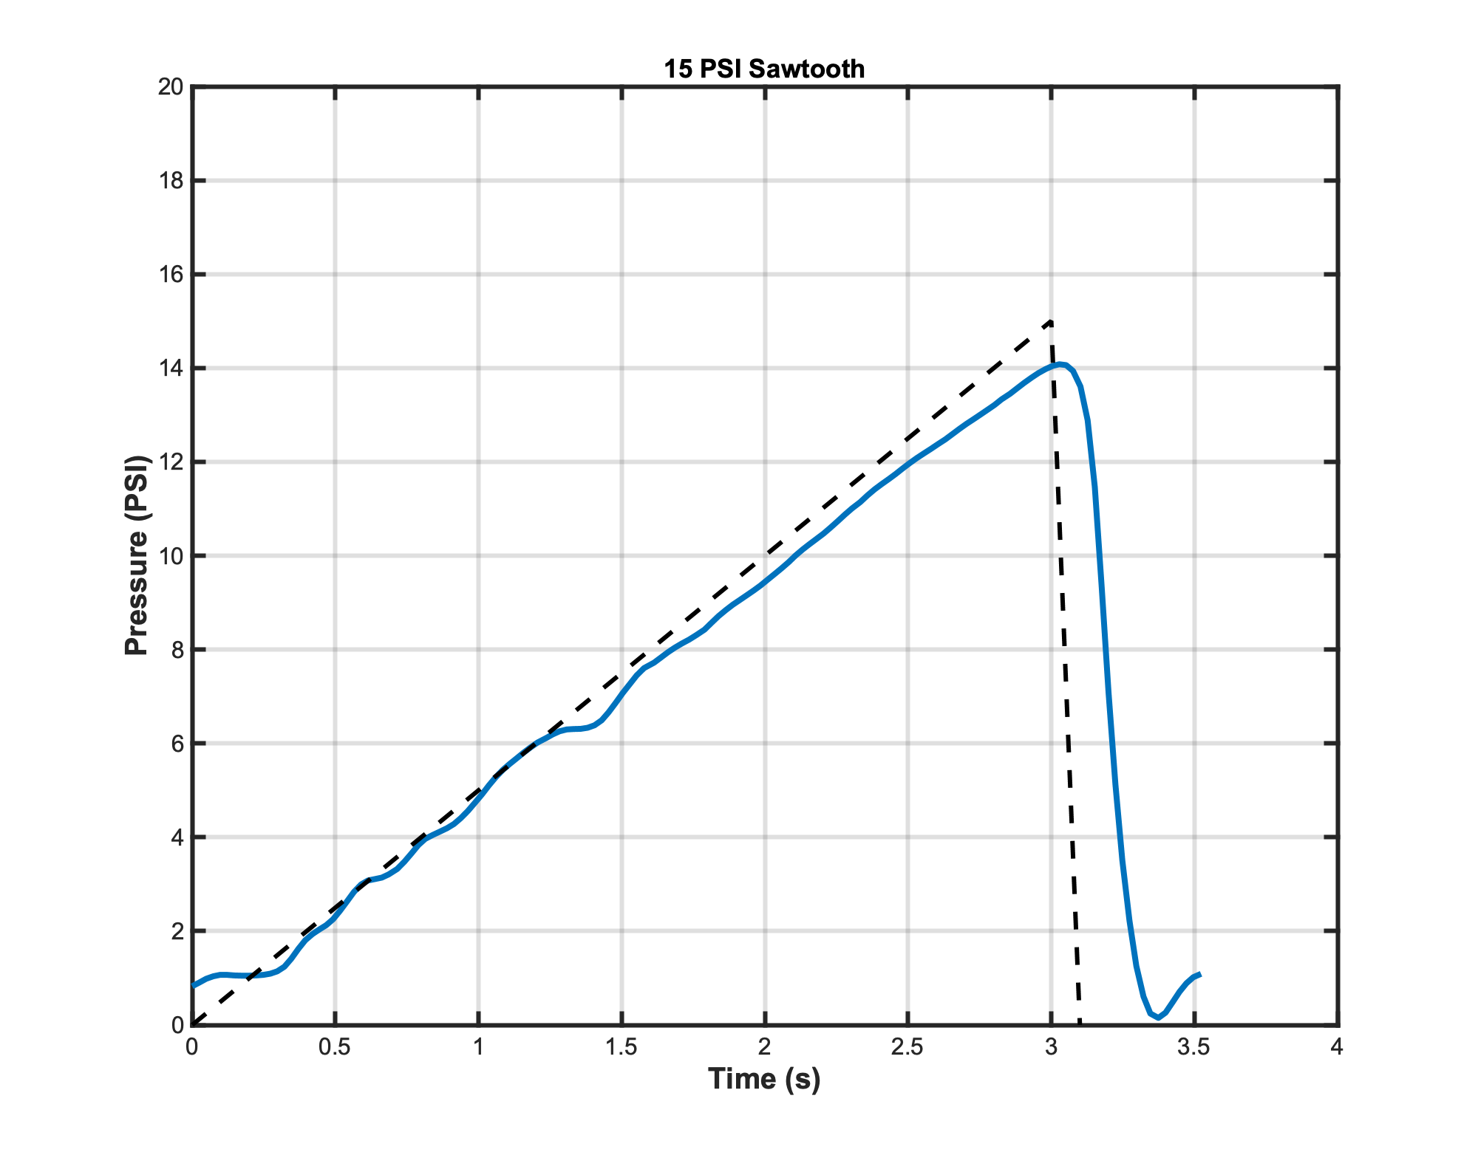
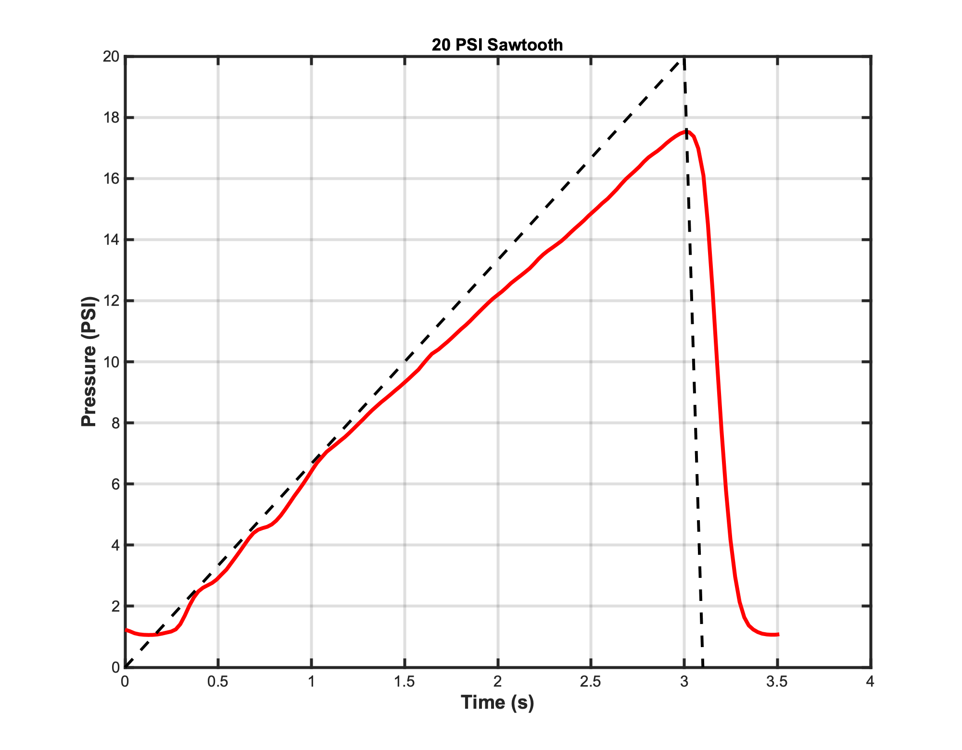
Versatile trajectory following
Notes:
Turn controller gains into function of pressure differential. Could model after electronics system

Slide 28
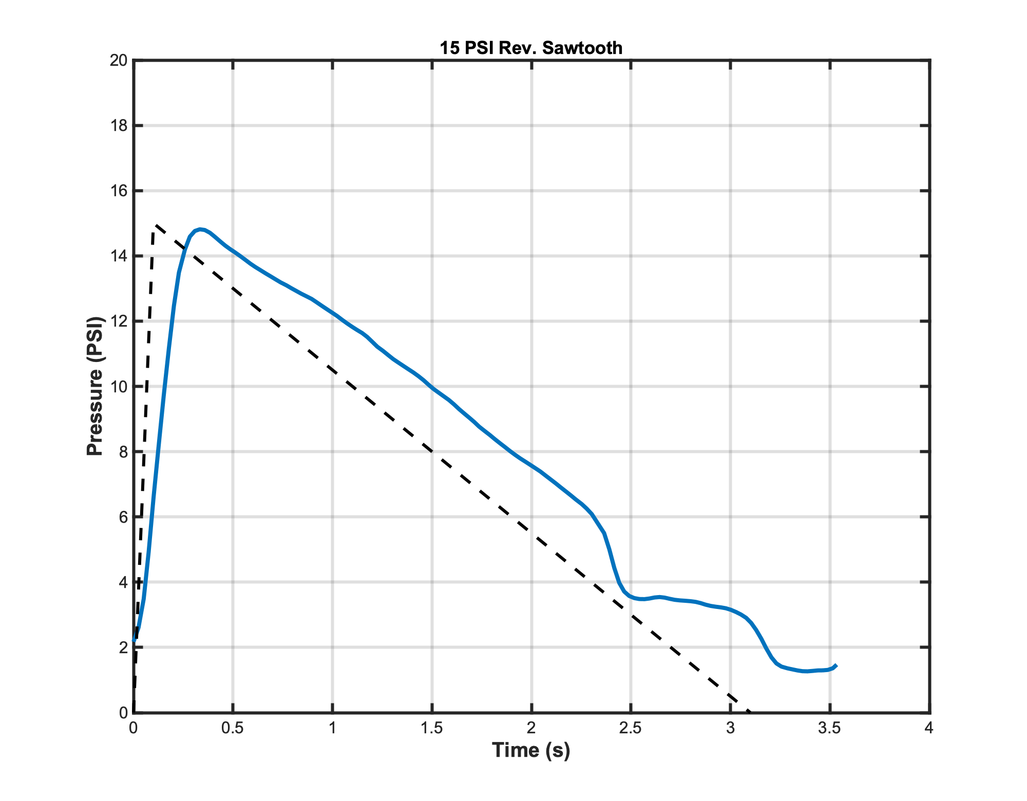
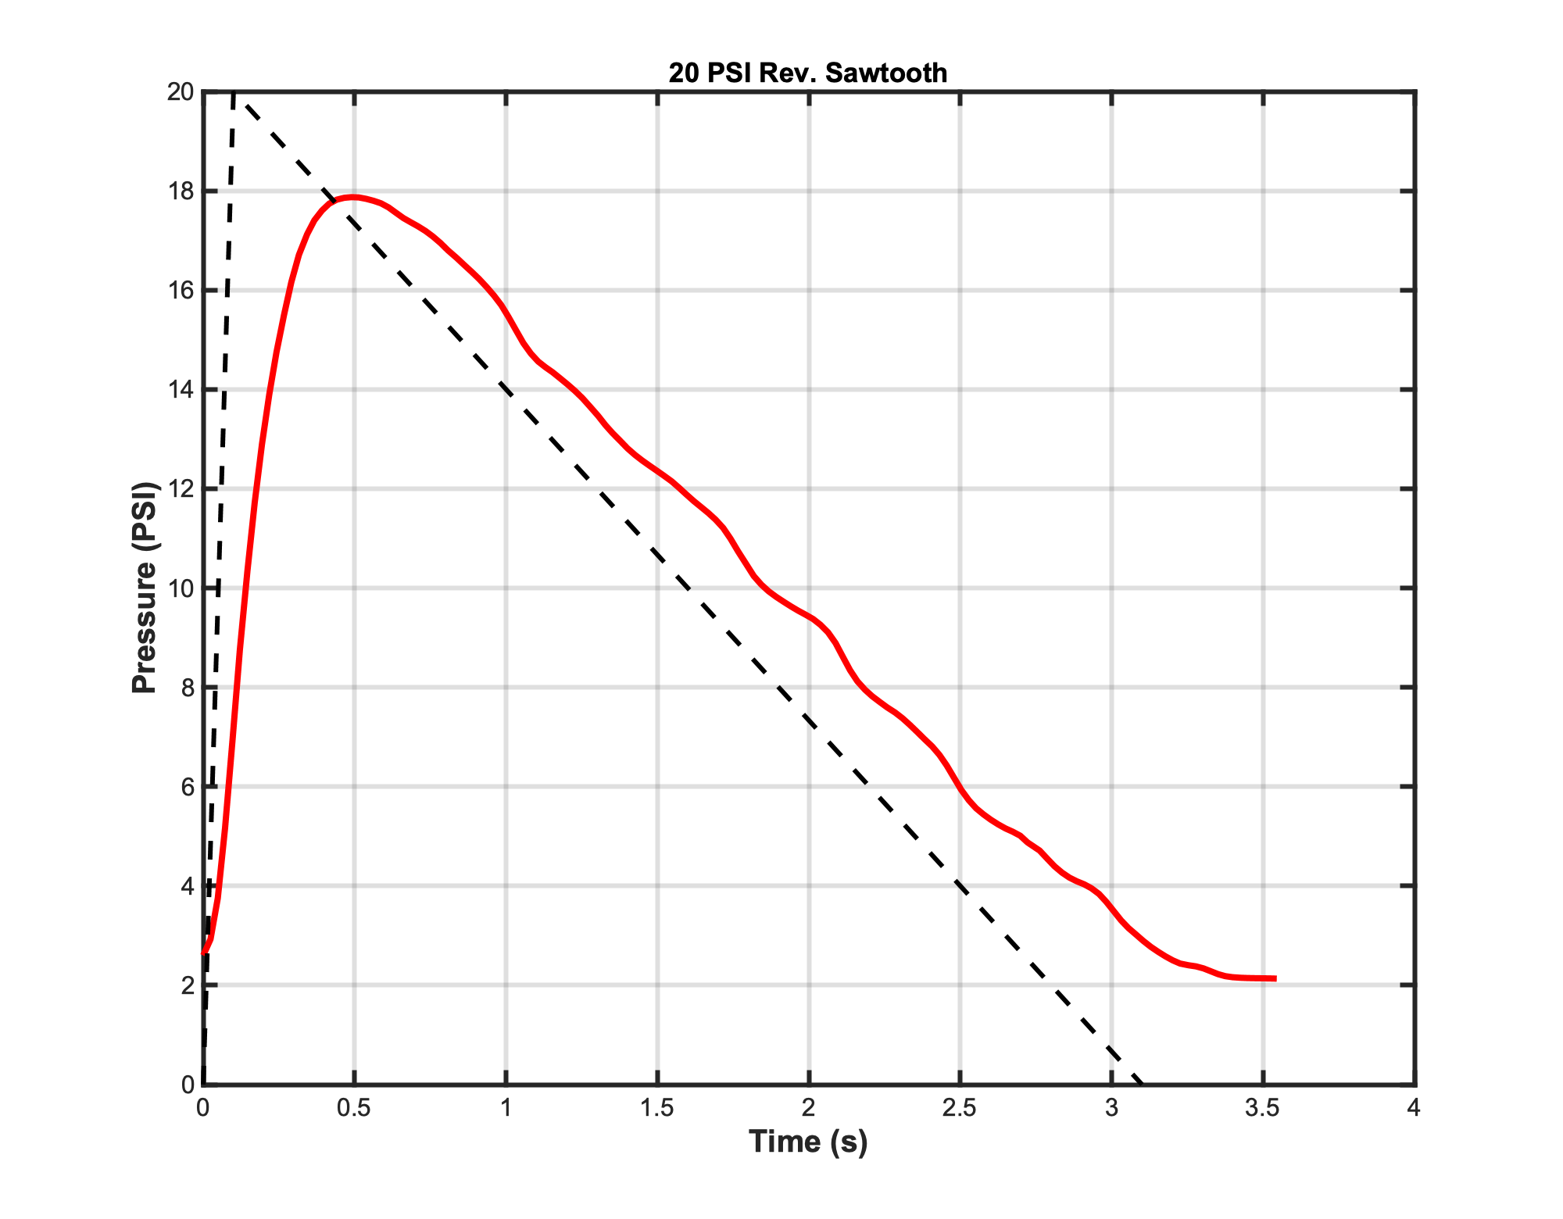
Versatile trajectory following cont.

Slide 29
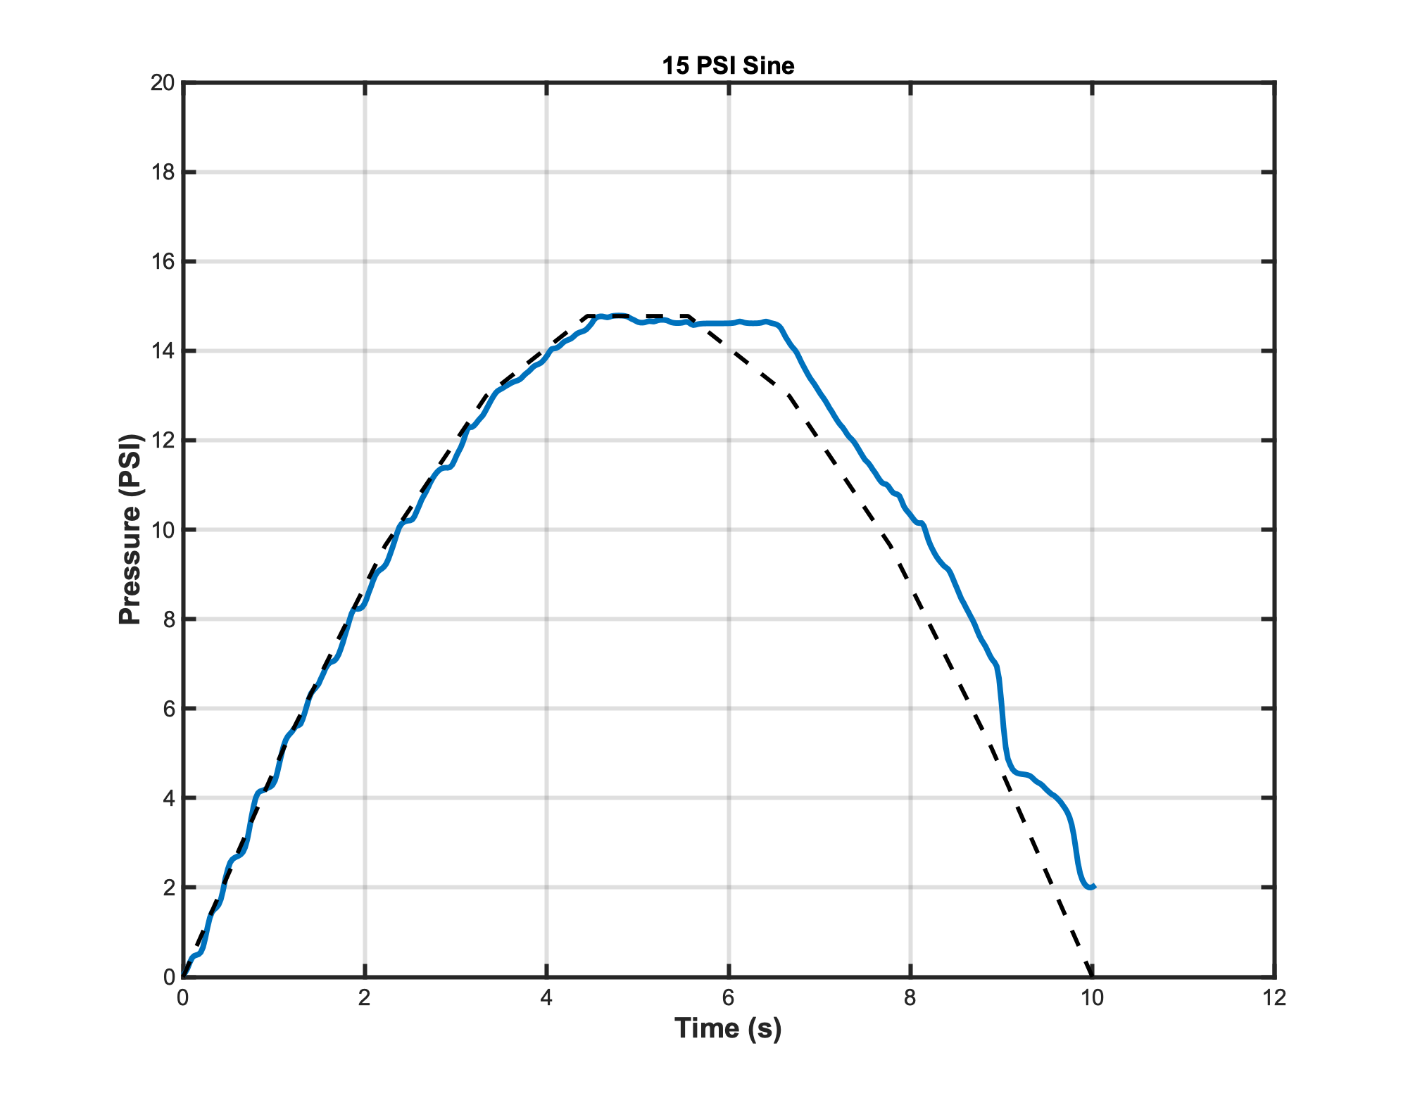
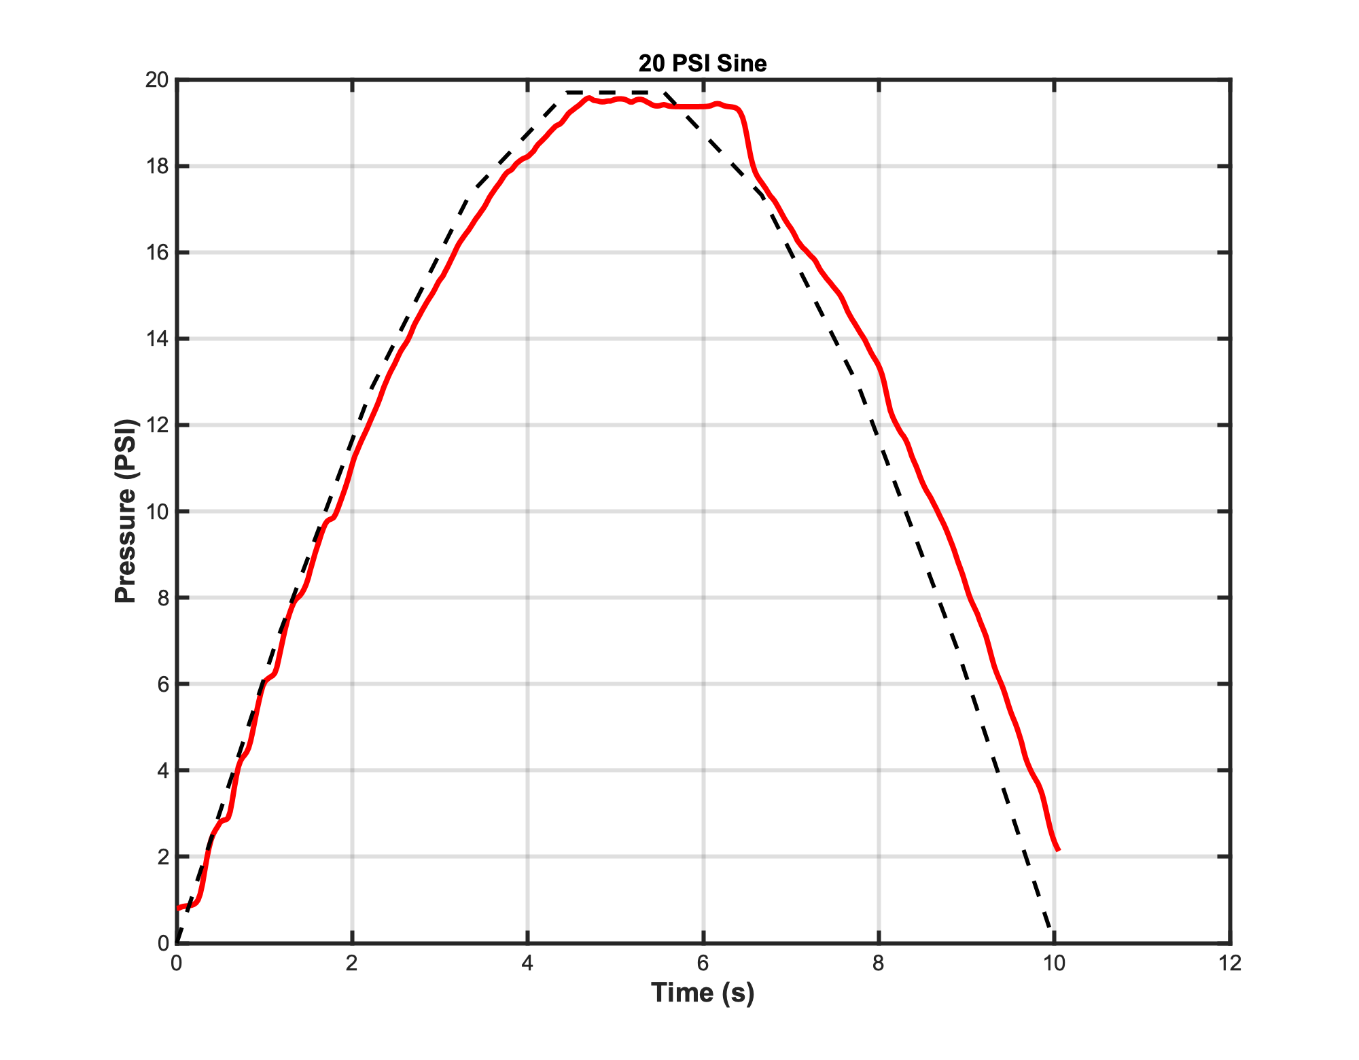
Versatile trajectory following cont.
Notes:
Flat <15 PSI top comes from the way I have discretized the sin wave in the controller code

Slide 30
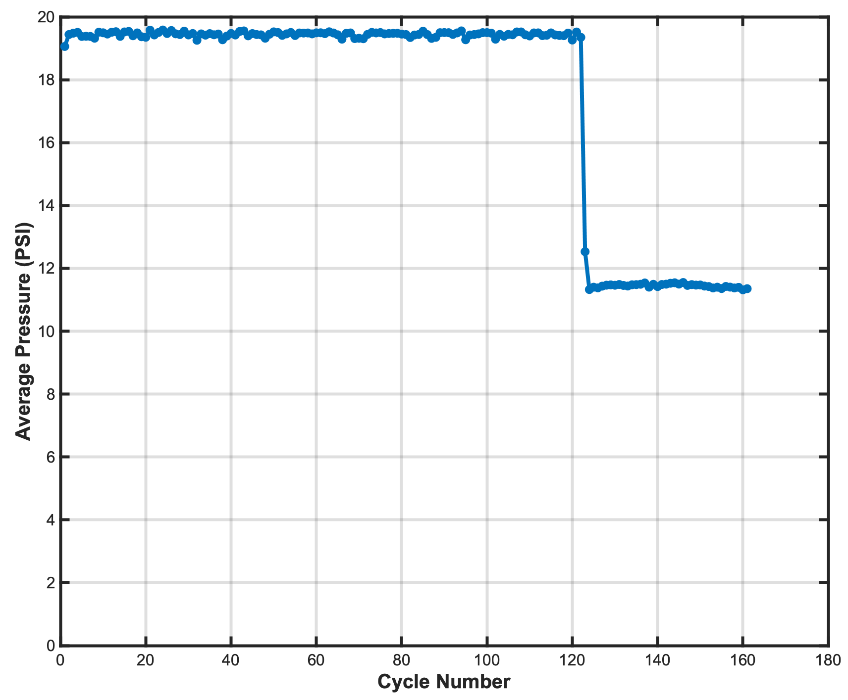
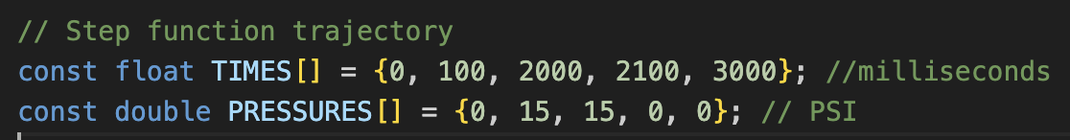
Cycle testing for actuator lifetime characterization
Each dot on the graph represents the average pressure during the ”top” of each step function from one cycle
Repeating trajectory cycle functions allows for infinite test lengths
Silpoxy seam burst
The “top” of the function
Notes:
Be sure to mention stop conditions embedded in the code. Mention how can be used for charlotte’s work to show different glue/material failures. Mention that processing is done in matlab so plenty of other ways to process the code

Slide 31
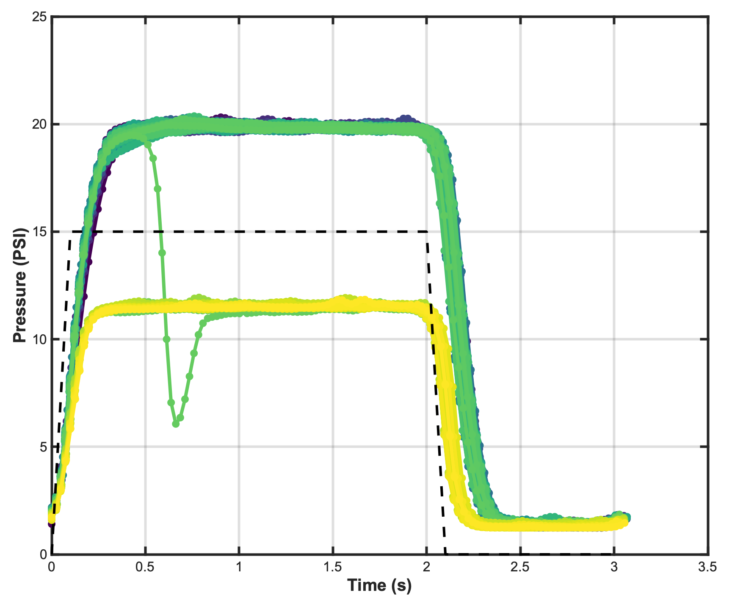
Cycle testing for actuator lifetime characterization
All Raw Data
Processed Version
Silpoxy seam burst
The “top” of the function
Notes:
Be sure to mention stop conditions embedded in the code. Mention how can be used for charlotte’s work to show different glue/material failures. Mention that processing is done in matlab so

Slide 32
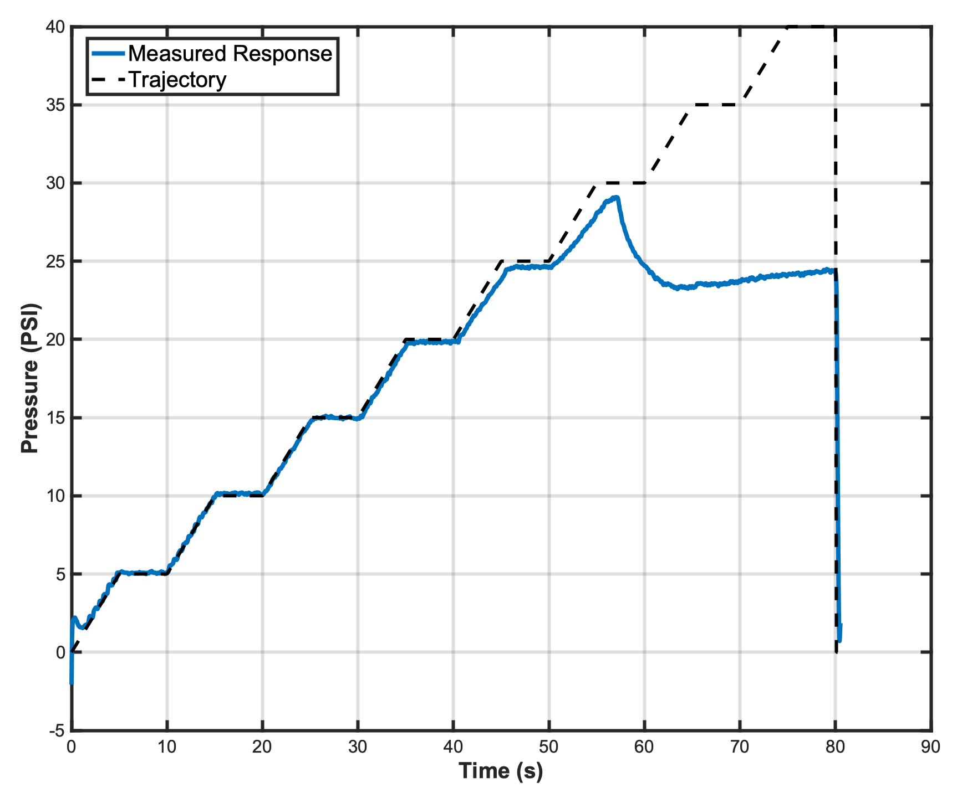
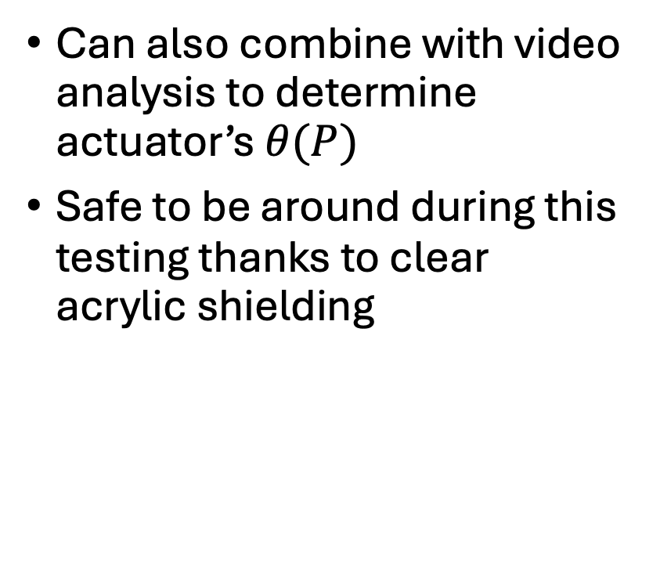
Burst testing for actuator limit characterization
Can also combine with video analysis to determine actuator’s $θ(P)$
Safe to be around during this testing thanks to clear acrylic shielding
Notes:
Mention safety glass. Add speaker short chirp to start timer theta(P)

Slide 33
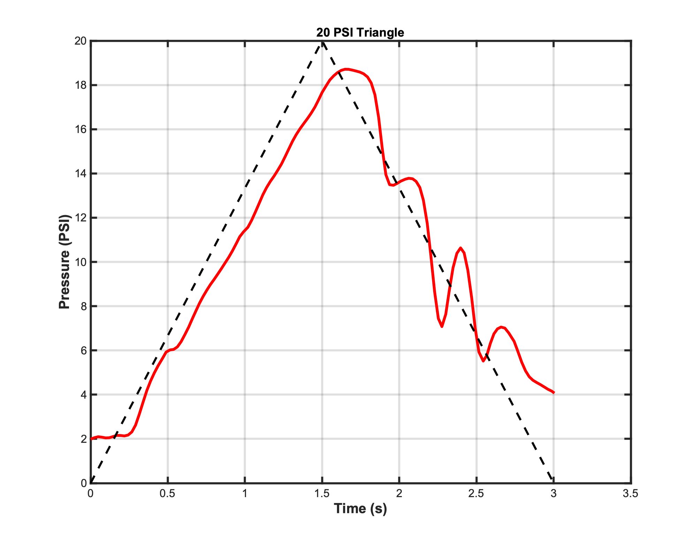


Controller limitations
Zeigler-Nichols tuning can be a time-intensive process
The controller struggles to follow negative slope trajectories near 10-13 PSI/sec. Currently unsure if that is actuator specific
At high setpoints, as the difference between overhead pressure and system pressure decreases, controller will begin struggling to maintain high accuracy
[8]
Notes:
Comment how proper traj following for a given actuator design could be costly in time and specimens (alberto)

Slide 34
Agenda
Motivation
Hardware
Control Software
Looking Ahead
Documentation

Slide 35



Potential expansion of scope
Up-to-date as of December 2024
Expand understanding and capability of test stand use with non-PnueNet actuator designs
Use the stand to learn what physical variables in a grasping scenario significantly impact actuator lifetime (i.e previously shown x₁ variable)
Test control software with solenoid valve of smaller flowrate
Integrate flowrate measurements into controller action
Notes:
Me or someone else, depending on what Kait thinks

Slide 36
Agenda
Motivation
Hardware
Control Software
Looking Ahead
Documentation

Slide 37
Documentation
This PowerPoint covers a higher-level overview of the motivation and design of the controller. The 3 Word documents associated with this test stand serve as deeper technical guides to specific functionalities of the controller, as well instructions on how to operate it. I recommend reading the documentation in the following order:
Controller Settings Overview
Install, Tune, & Run the Controller
How to Write a Trajectory Function
The code also features heavy documentation with comments explaining function and variable purposes, as well as step-by-step logic explanations for the main controller trajectory loop

Slide 38
References
[1] Doris et al. – 2024 – Automated Computational Design of Soft Robots for Functionality and Durability – Under Review
[2] Puhlmann et al. – 2022 – RBO Hand 3: A Platform for Soft Dexterous Manipulation
[3] Preechayasomboon and Rombokas – 2020 – Negshell casting: 3D-printed structured and sacrificial cores for soft robot fabrication
[4] Hawkes et al. – 2021 – Hard questions for soft robotics
[5] Case and Marvel – 2024 – FY24 Soft Robotics Report
[6] Baines et al. – 2024 – The need for reproducible research in soft robotics
[7] Gao et al. – 2023 – Research Status and Prospects of Control Strategies for High Speed On/Off Valves
[8] Clippared Electronic Valve Datasheet: https://www.clippard.com/downloads/PDF_Documents/Product%20Data%20Sheets/Clippard%20EV%20Series%20Electronic%20Valves.pdf

